Slide 1

Harper
WEB 170
Web Graphics and Prototyping
Redesign Suzanne Collins Books Site
Maryann Jordan
Fall 2019

Slide 2
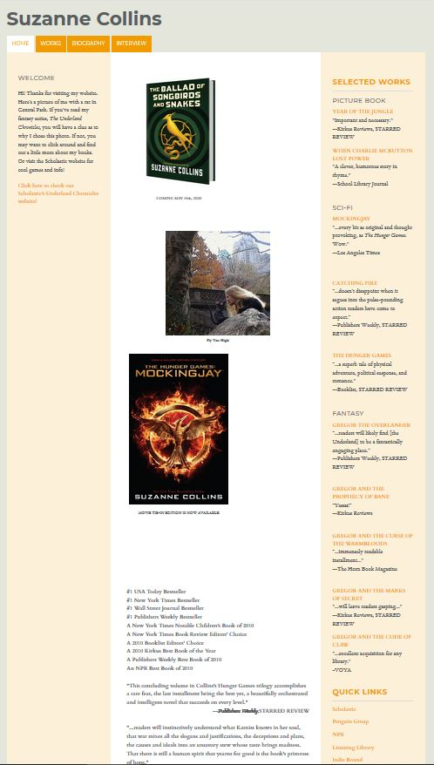
How I found
SUZANNECOLLINSBOOKS.COM.
The site was on lists of the worst websites.

Slide 3
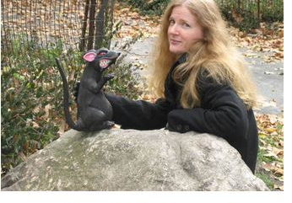
Why redesign SUZANNECOLLINSBOOKS.COM?
The site needs improvement and modernizing.
I can relate to the business of the site so I thought it would be
great for my first redesign.
A popular author should have a
modern designed website which
is user friendly. ☺

Slide 4
Why redesign SUZANNECOLLINSBOOKS.COM?
The current site issues are
- OLD STYLE navigation and design
- HARD TO READ SMALL FONT
TOO MUCH WHITE SPACE
Little information on each book
- NO BOOK SPECIFIC LINKS to purchase
- ONLY awards/reviews book detail page
UNORGANIZED text / images
No contact page /footer
No search

Slide 5
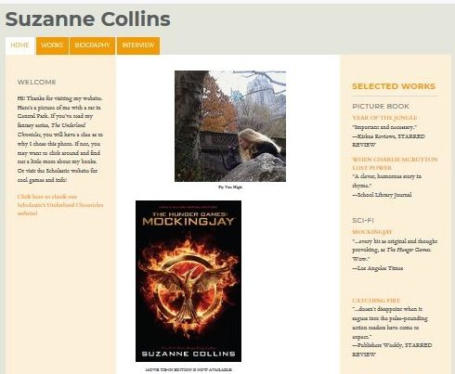
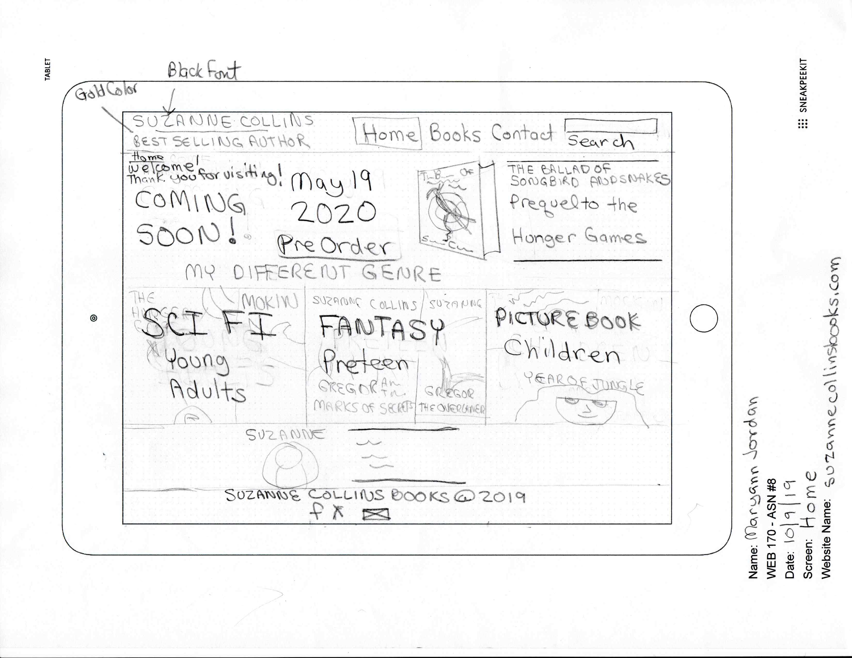
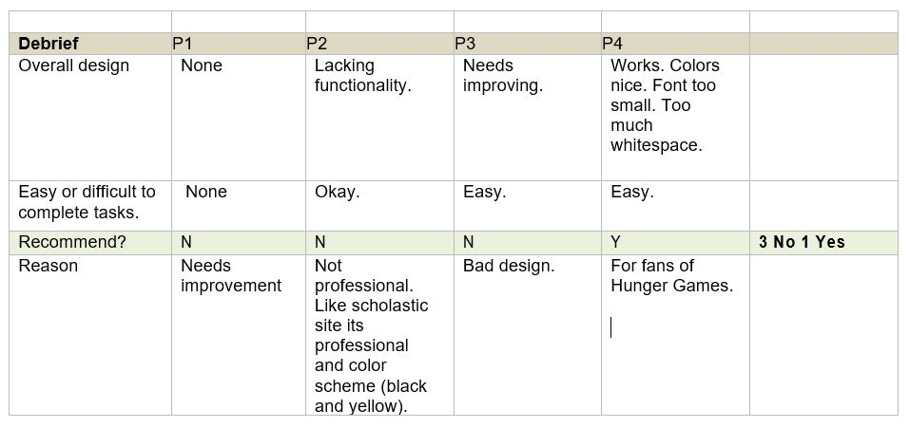
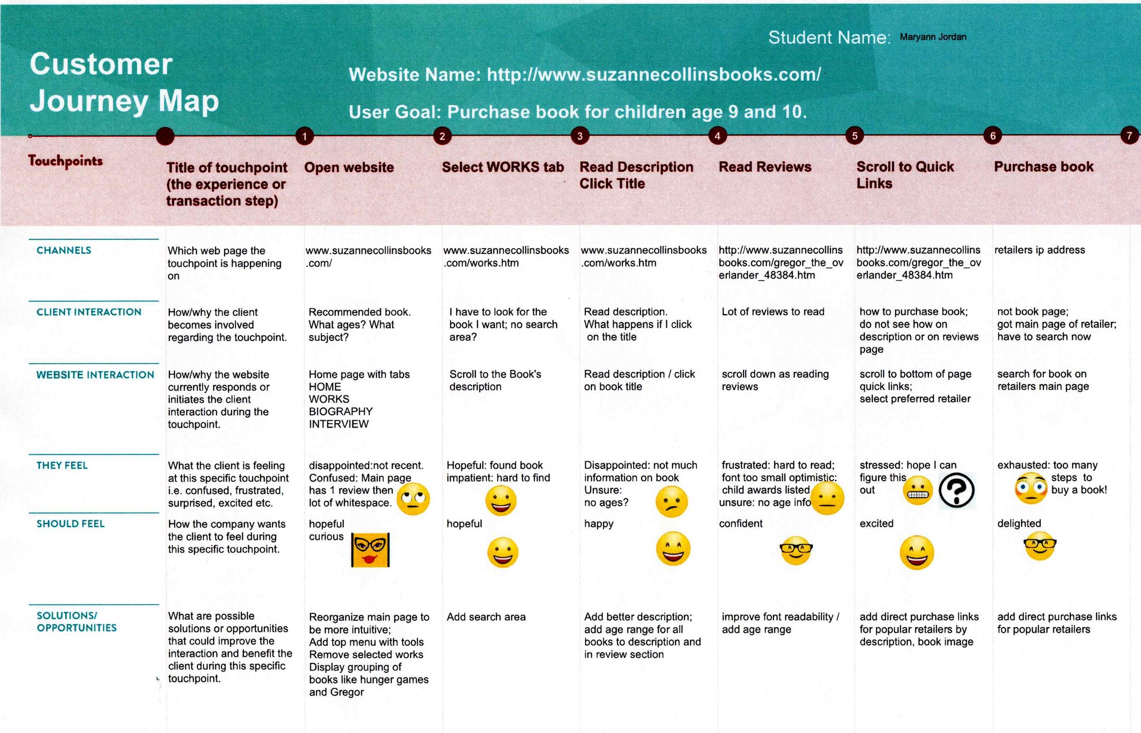
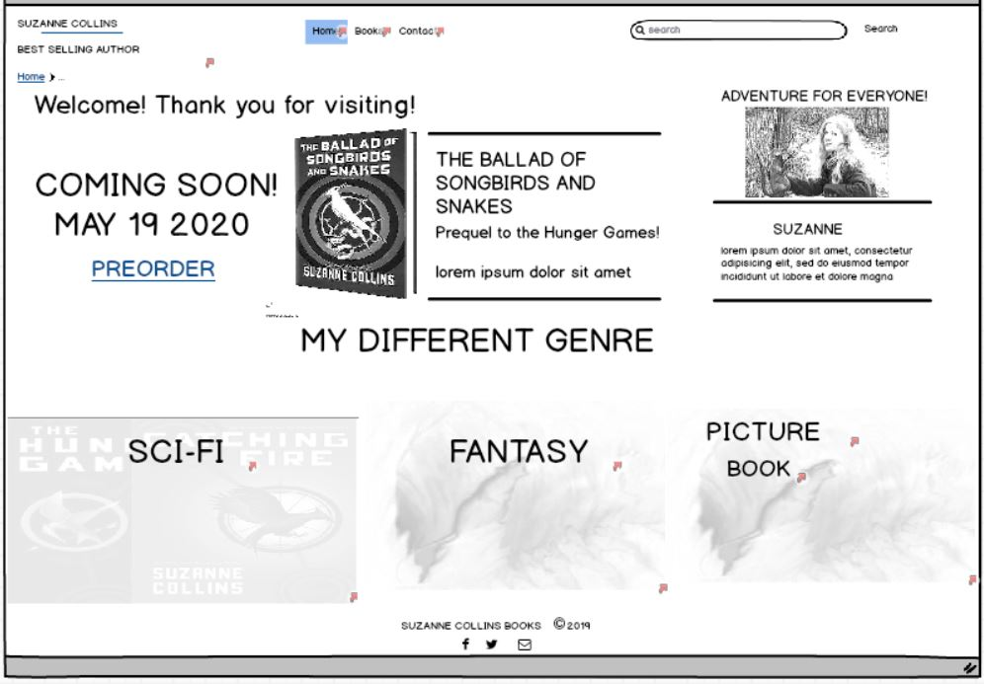
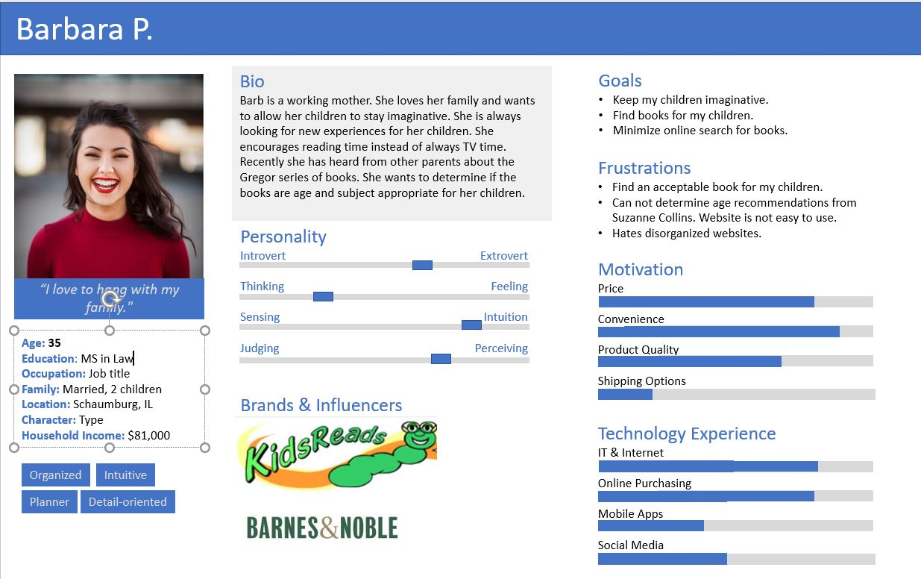
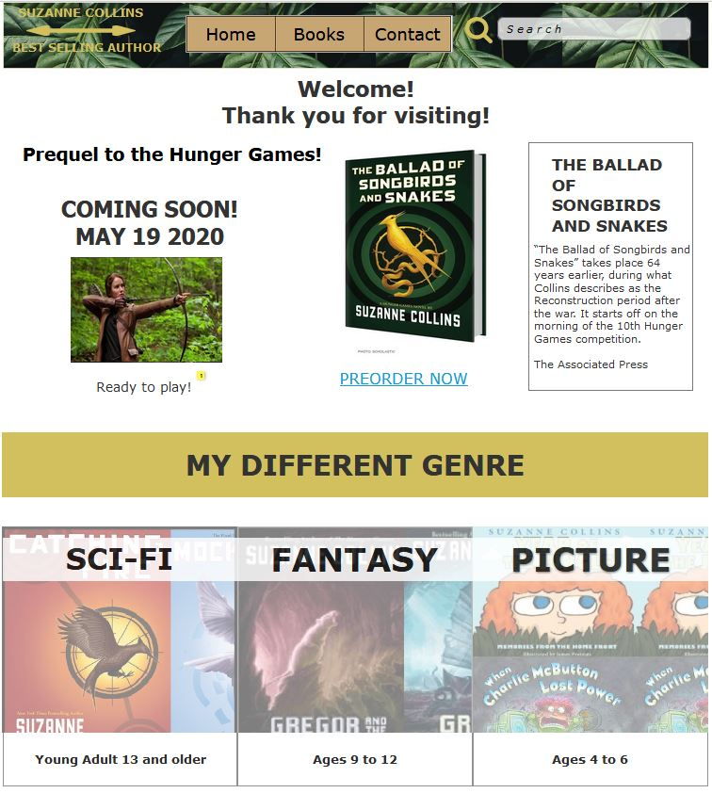
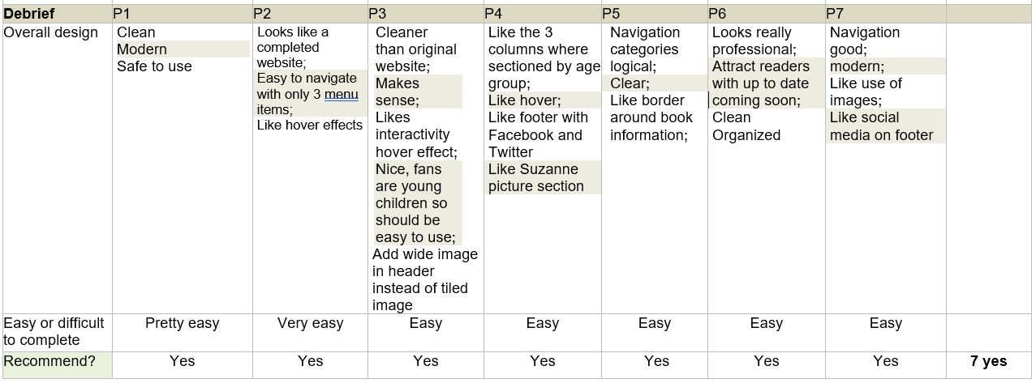
Redesign Site
ANALYZE
WIREFRAME SKETCHES
USER TEST Original Site
PERSONA /
JOURNEY MAP
DIGITAL
WIREFRAME
PROTOTYPE
USER TEST Prototype
WWW.SUZANNECOLLINSBOOKS.COM

Slide 6
ANALYZE
WWW.SUZANNECOLLINSBOOKS.COM
WEBSITE REDESIGN GOALS:
SOLVE USABILITY ISSUES
USEFUL
LEARNABLE
EFFICIENT
FUN

Slide 7
PURPOSE OF SITE?
The purpose of the current SuzanneCollinsBooks.com is to
provide the author’s fans with a place to get information about the author, and her works. She most known for the world-famous Hunger Games trilogy and her popular Underland series.
WWW.LAVIEN.COM
WHO WILL USE THE SITE?
Fans of her books
All ages including young children
WHAT INFO/TASKS ARE USEFUL FOR USER?
Book description and reviews
Author background
Purchasing book
Contacting Author
BOOK ADVENTURES
WWW.SUZANNECOLLINSBOOKS.COM

Slide 8
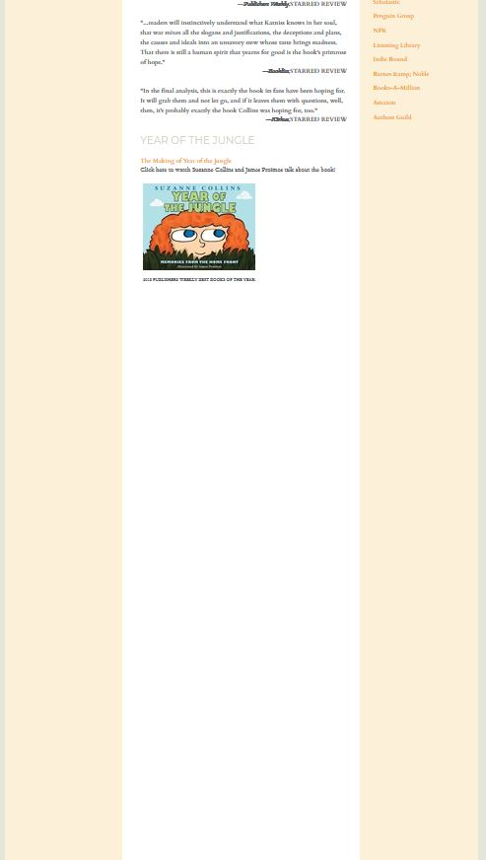


Issues of Original Site
Old Style Navigation
HOME Page
Hard to read
Small
Font
No Descriptions just reviews
Unorganized
White Space
Images
Have
To
Keep
Scrolling…
Too
Much
White
Space
Unorganized
Information
Hard to find links to Purchase Books
User must search on vendor site for book
No Footer
WWW.SUZANNECOLLINSBOOKS.COM

Slide 9
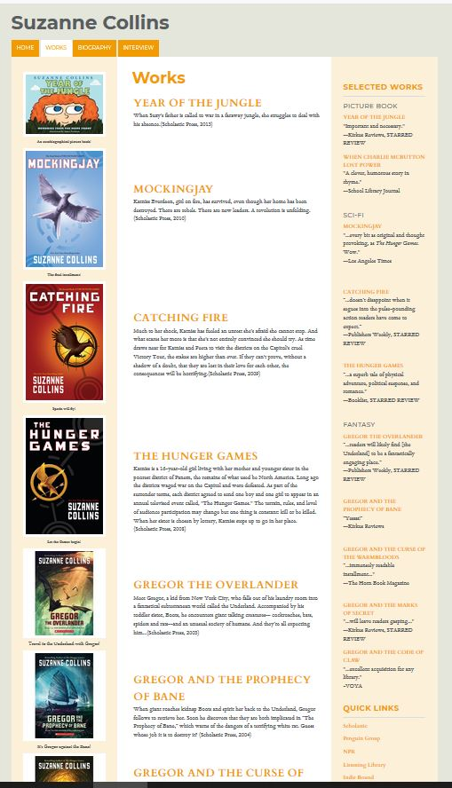

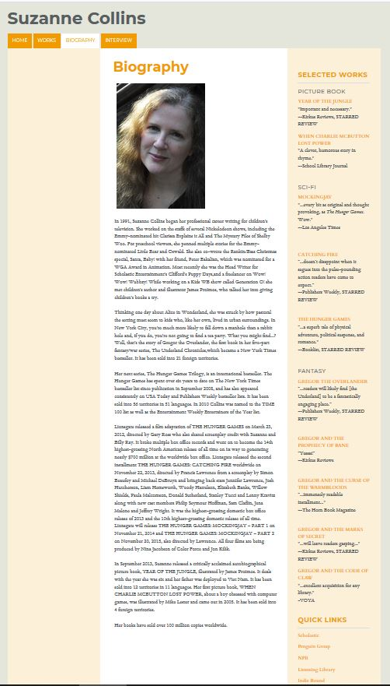
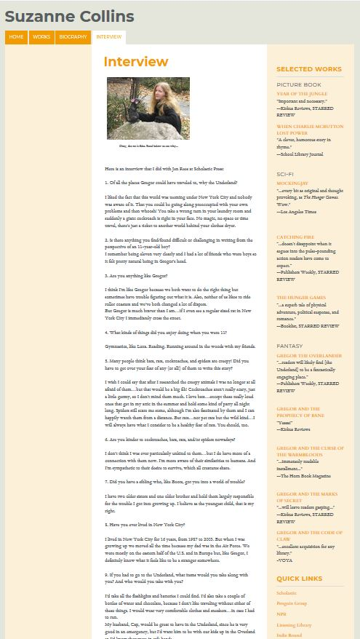
Issues of Original Site
Works Page
Detail Page
Bio Page
Interview Page
Unorganized
White Space
Images
Small Font
No Descriptions just awards/ long reviews
Hard to Purchase Books
Scroll to find books
Hard to scan
for info
No Footer
WWW.SUZANNECOLLINSBOOKS.COM

Slide 10
Redesign Site
ANALYZE
WIREFRAME SKETCHES
USER TEST Original Site
PERSONA /
JOURNEY MAP
DIGITAL
WIREFRAME
PROTOTYPE
USER TEST Prototype
WWW.SUZANNECOLLINSBOOKS.COM

Slide 11
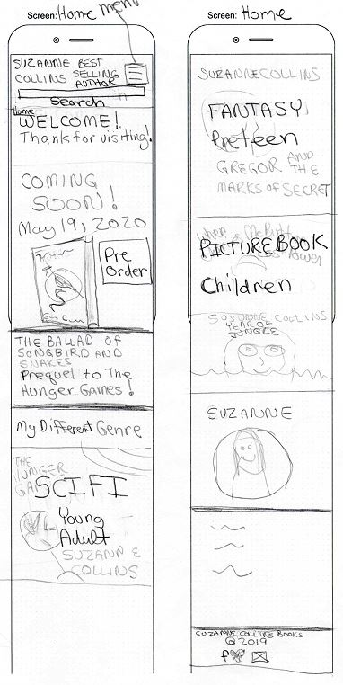
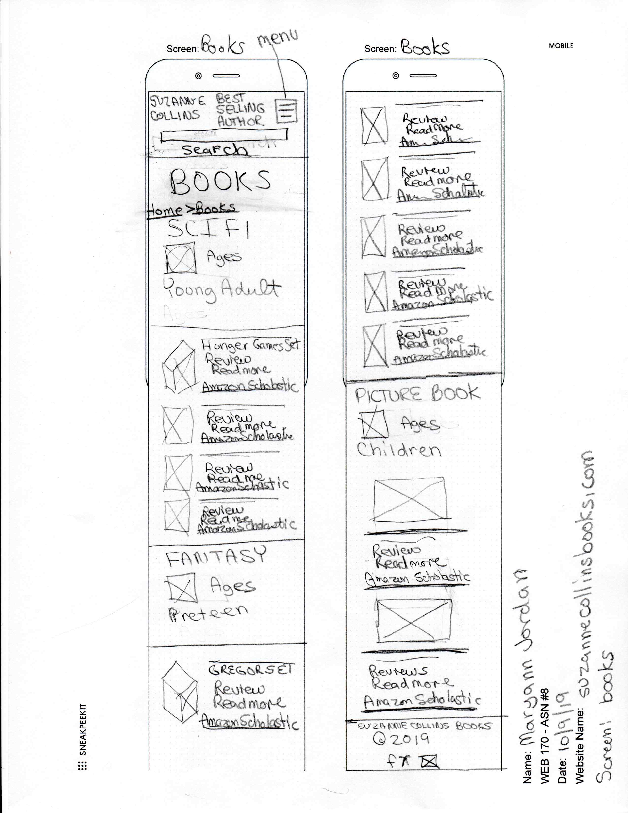
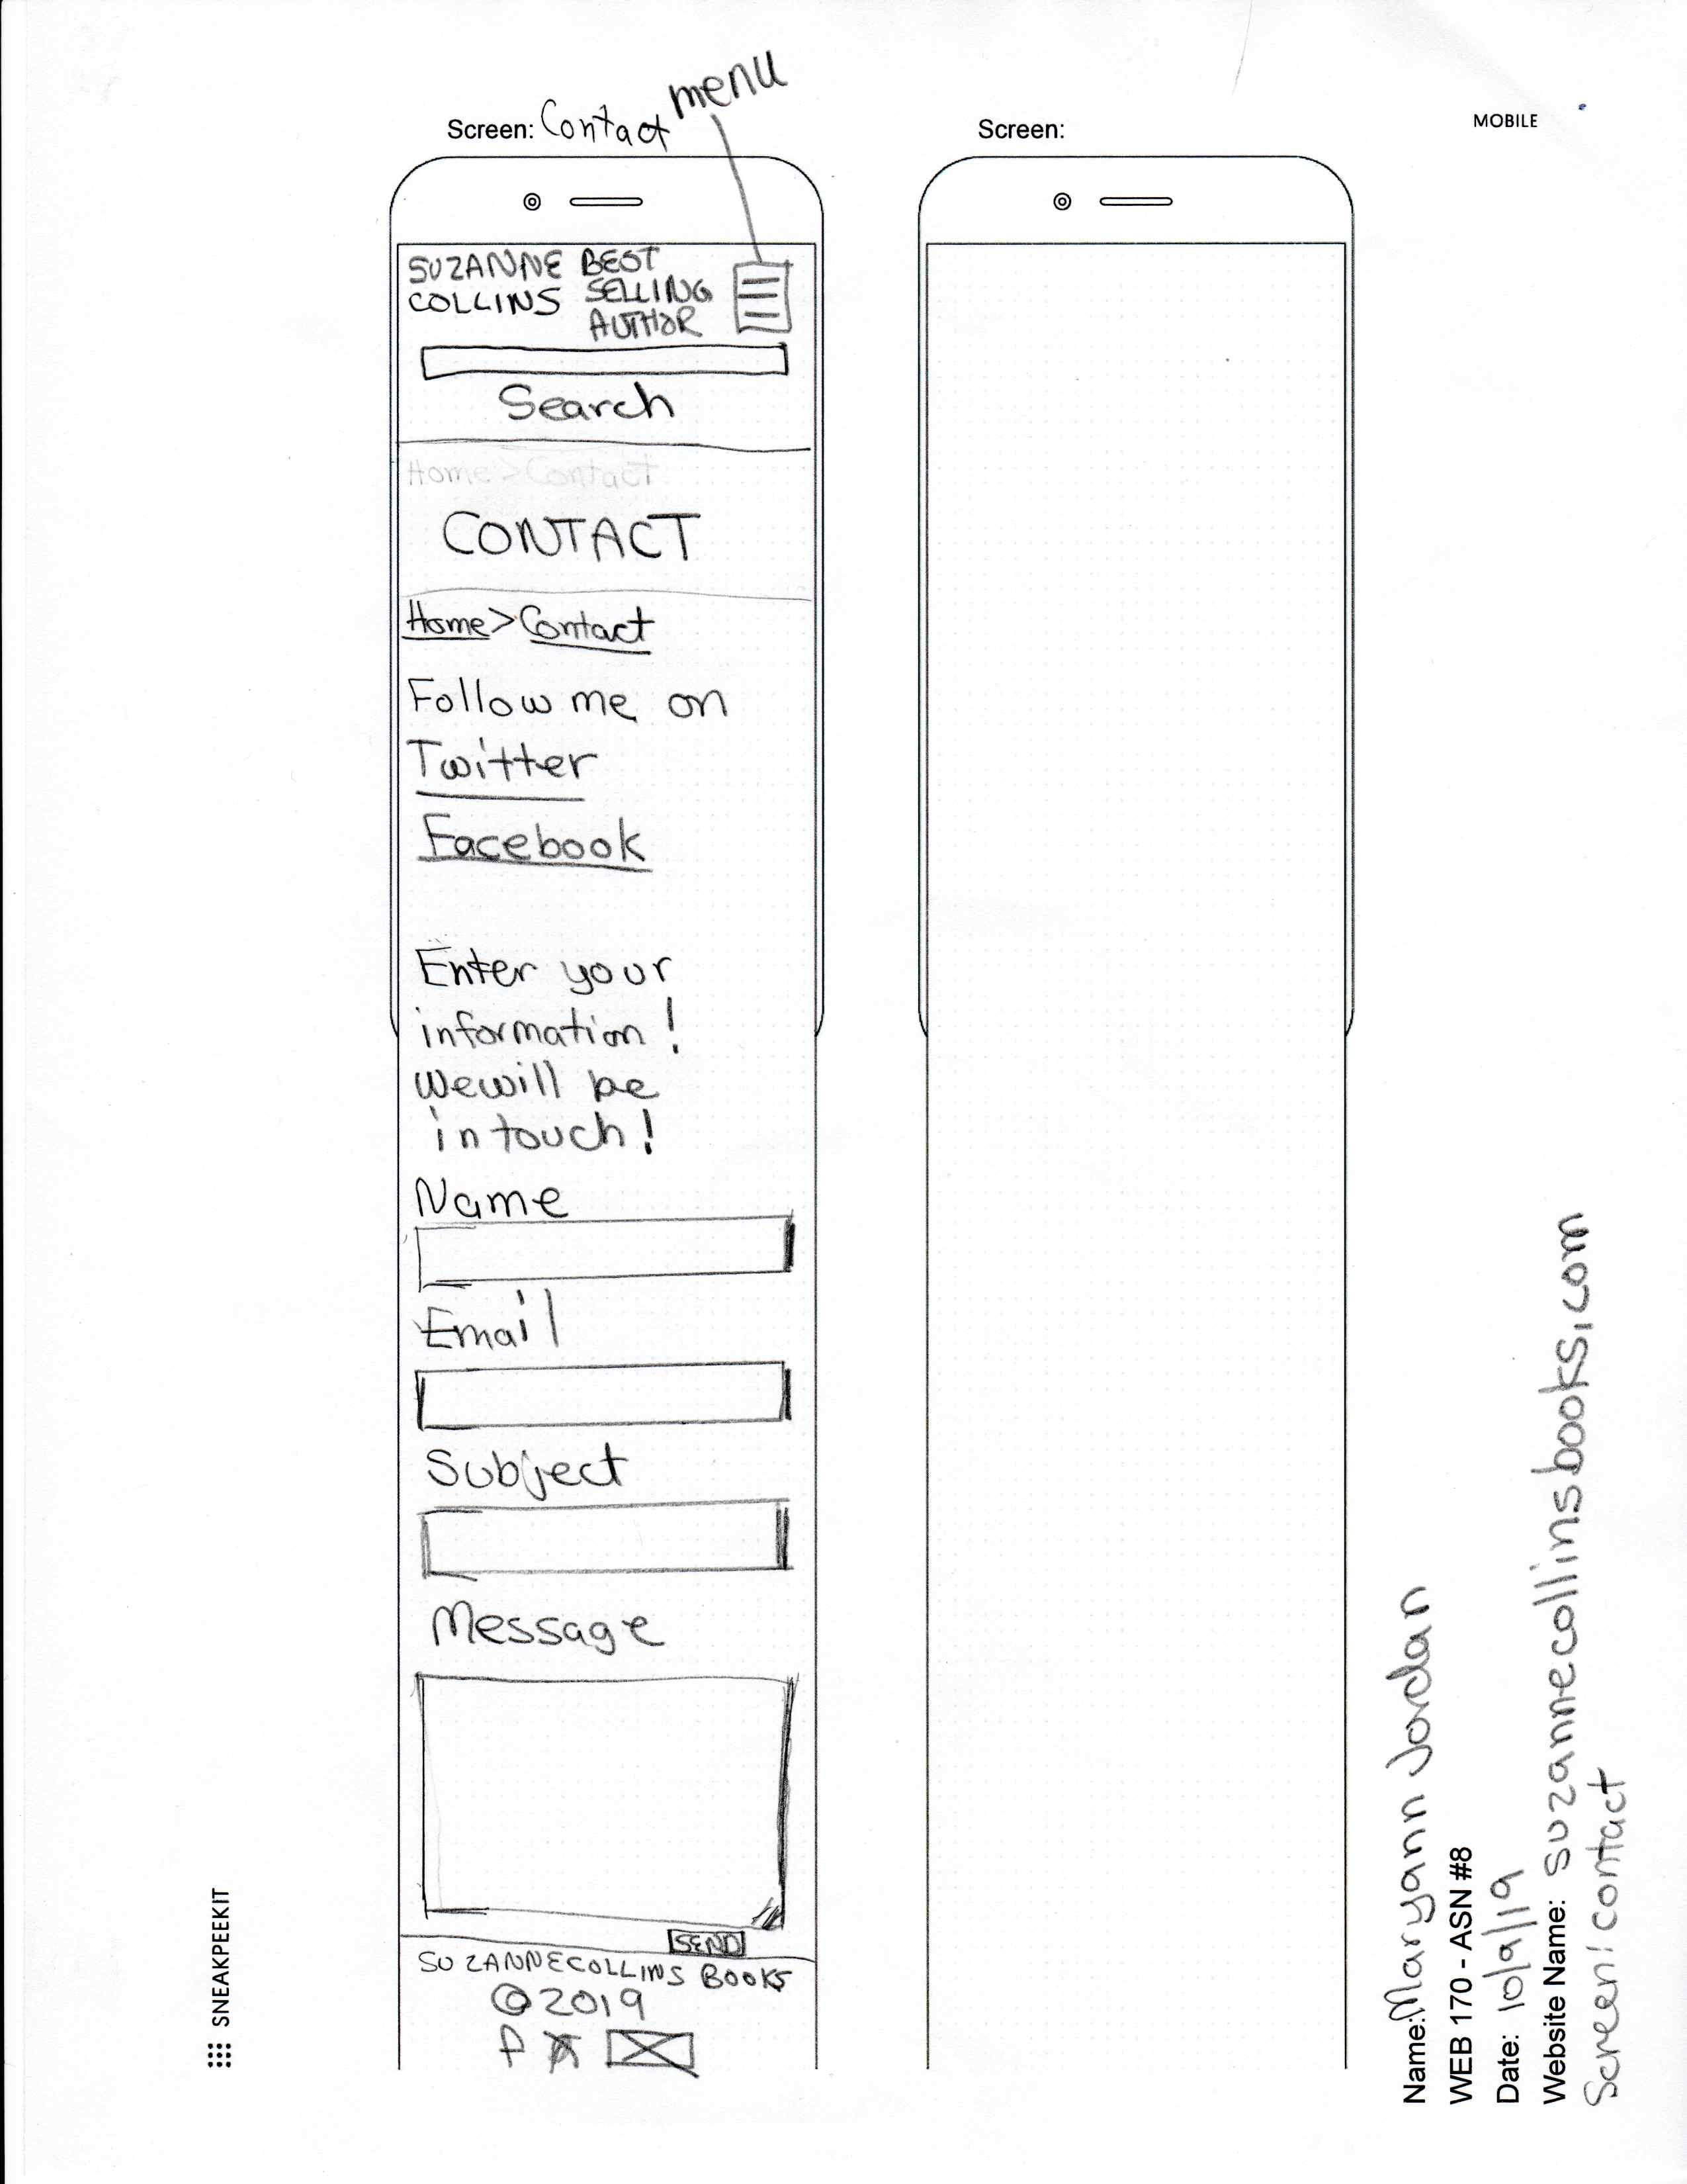
MOBILE
Coming soon!
Sketches
Mobile First
Organize by Genre
Add Purchase Links
For each book
New Contact Page
Footer with
Social media
Add search
WWW.SUZANNECOLLINSBOOKS.COM

Slide 12
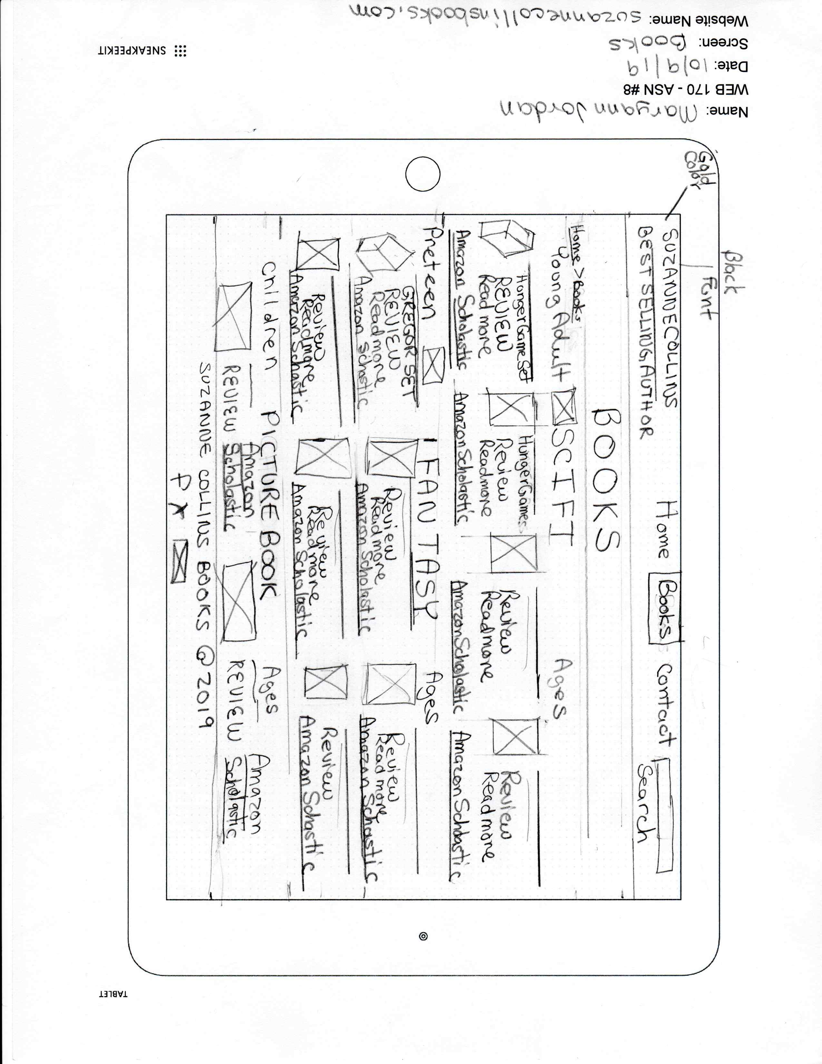
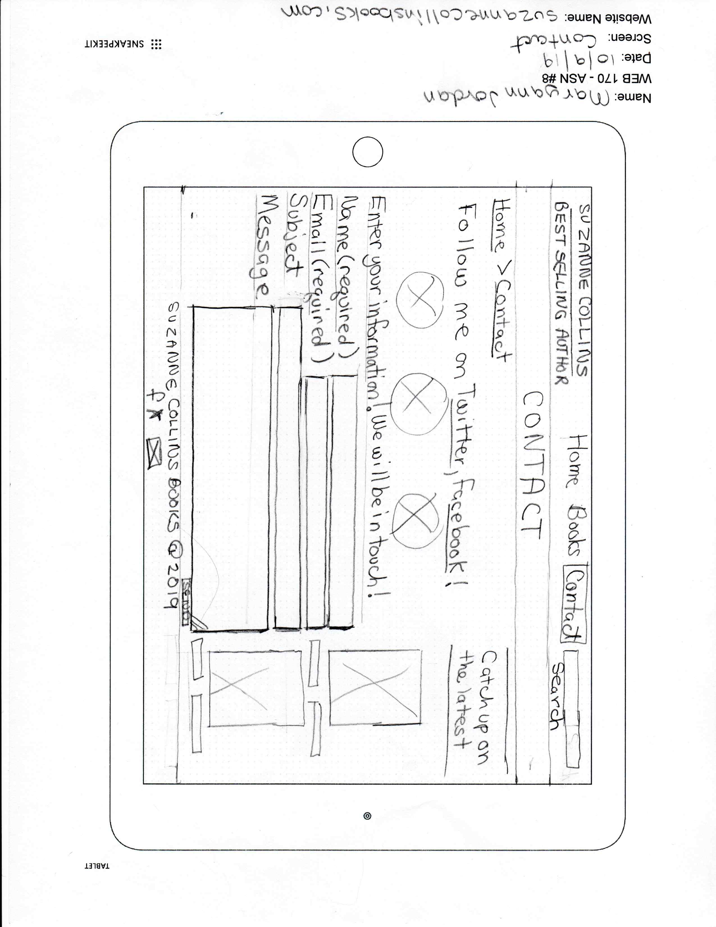
Tablet
Sketches
Tablet Second
Add Purchase Links
Coming soon!
Organize by Genre
New Contact Page
Add search
Footer with
Social media
WWW.SUZANNECOLLINSBOOKS.COM

Slide 13
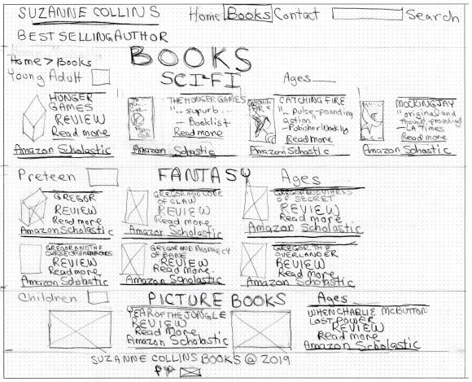
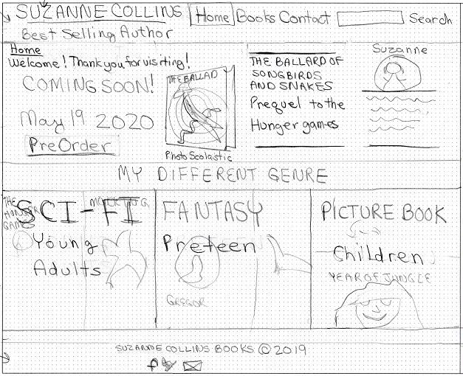
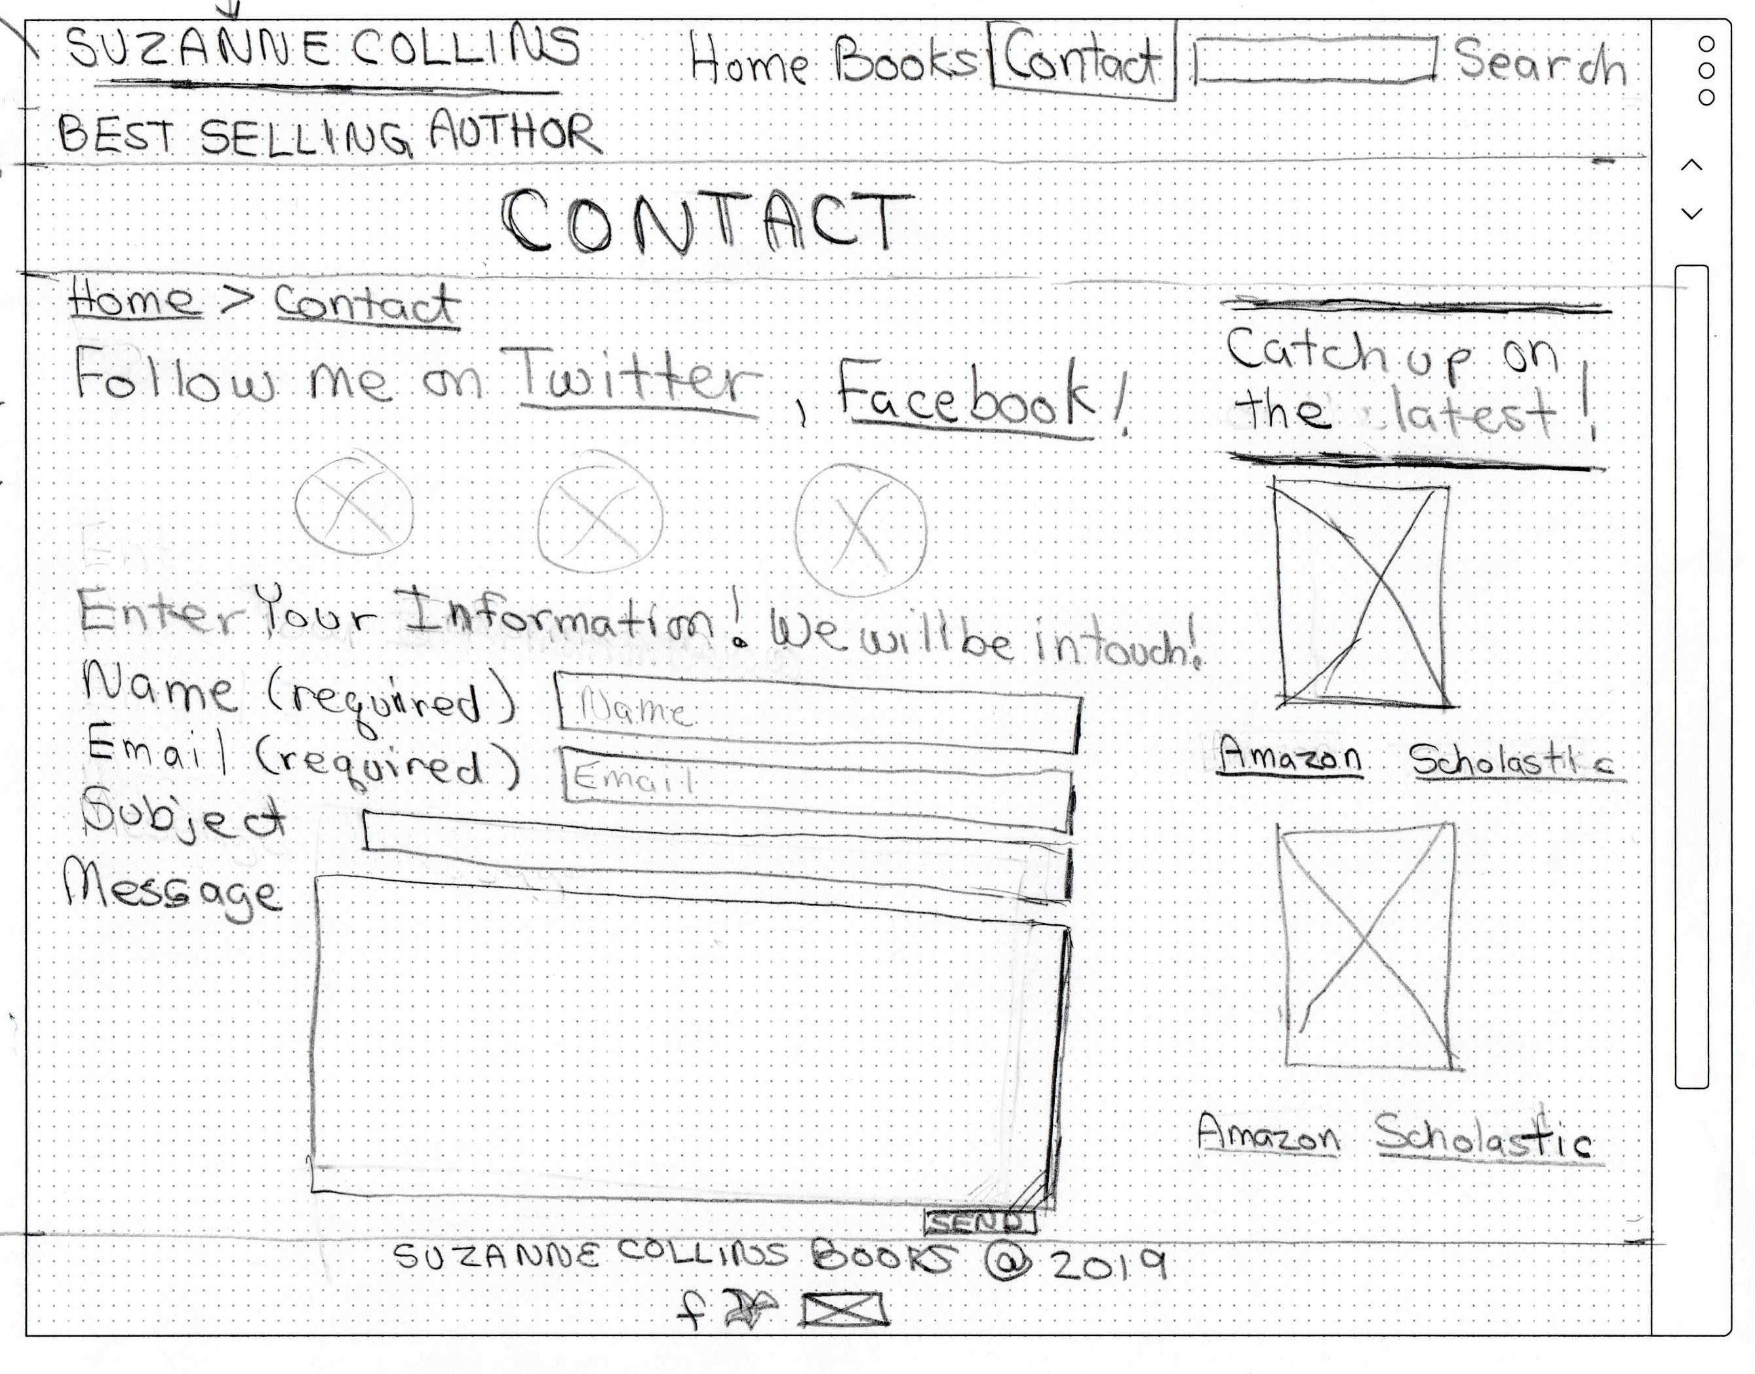
DESKTOP
Desktop Third
Sketches
Coming soon!
Organize by Genre
Add Purchase Links
New Contact Page
Add search
Footer with
Social media
WWW.SUZANNECOLLINSBOOKS.COM

Slide 14
Redesign Site
ANALYZE
WIREFRAME SKETCHES
USER TEST Original Site
PERSONA /
JOURNEY MAP
DIGITAL
WIREFRAME
PROTOTYPE
USER TEST Prototype
WWW.SUZANNECOLLINSBOOKS.COM

Slide 15
Original Site
User Test 1
Scenario 1:
Another parent recommends a Suzanne Collins book “GREGOR AND THE MARKS OF SECRET”. You decide to look up the book on the authors website to see if it is age and subject appropriate for your child.
Assume you are a parent with young children aged 9 and 10 years old.
Scenario 2:
After reading about the storyline of the book “GREGOR AND THE CODE OF CLAW”, you want to look on the authors website for reviews to see if you should purchase for your child. Assume you are a parent of a young child aged 11.
Scenario 3:
You want to complete your Hunger Games collection.
Buy Suzanne Collins’ third book in the Hunger Games series, “MOCKINJAY”sing the authors website.
WWW.SUZANNECOLLINSBOOKS.COM

Slide 16
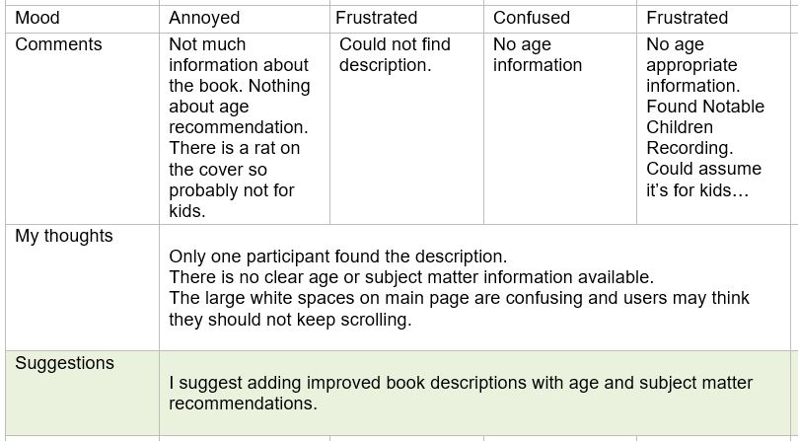
Scenario 1:
Find description of a book for a child including age &
subject matter recommendations
Results: Only one participant found the description.
Issues: Users were frustrated trying to find info
Improve: Add efficient way to find book desc & age recommendations
WWW.SUZANNECOLLINSBOOKS.COM
Original Site
User Test 1

Slide 17
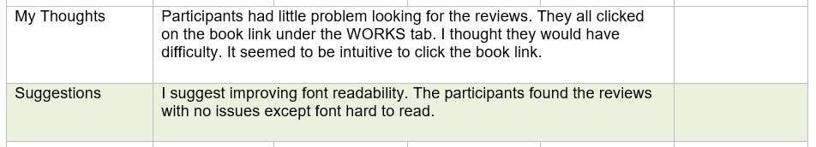
Original Site
User Test 1
Scenario 2:
Look for reviews for a book for your child
Results: All users found the reviews
Issues: Users mentioned font was hard to read
Improve: Use larger readable font
WWW.SUZANNECOLLINSBOOKS.COM

Slide 18
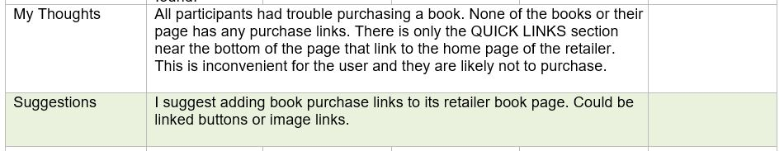
Original Site
User Test 1
Scenario 3:
Buy MOKINGJAY Book
Results: No one could purchase the book. Users were confused
Issues: No specific book purchase links
Improve: Include purchase links for each book.
WWW.SUZANNECOLLINSBOOKS.COM

Slide 19
Original Site
User Test 1
Usability Test and Findings
- Not much INFORMATION about the book
UNORGANIZED images with little text
No RESPONSE when clicking on images and text to complete a task
Hard to read small FONT
Too much WHITE SPACE disorients the user
Users UNNECESSARILY SCROLLING up and down to try to find what they’re looking for.
WWW.SUZANNECOLLINSBOOKS.COM

Slide 20
Original Site
User Test 1
Usability Test Suggested Improvements
Use white space to improve user experience
Improve book description
- Add intuitive way to find book description and age recommendations
- Use larger readable font with headers
- Include purchase links for each book
WWW.SUZANNECOLLINSBOOKS.COM

Slide 21
Redesign Site
ANALYZE
WIREFRAME SKETCHES
USER TEST Original Site
PERSONA /
JOURNEY MAP
DIGITAL
WIREFRAME
PROTOTYPE
USER TEST Prototype
WWW.SUZANNECOLLINSBOOKS.COM

Slide 22
Persona
Personas are fictional characters who represent a target user of the website.
Barb is a professional woman who got recommendations for a SC book for her children. She wants her children to use their imagination.
WWW.SUZANNECOLLINSBOOKS.COM

Slide 23
Journey Map Original Site
After creating personas, journey maps should be generated from user research.
A customer journey map outlines what your personas, leads, and customers will experience when they use your site.
This Journey map’s user goal is to purchase a recommended book for children aged 9 and 10.
The user had a lot of issues finding information and purchasing the book.
- Sam Walton
WWW.SUZANNECOLLINSBOOKS.COM

Slide 24
Redesign Site
ANALYZE
WIREFRAME SKETCHES
USER TEST Original Site
PERSONA /
JOURNEY MAP
DIGITAL
WIREFRAME
PROTOTYPE
USER TEST Prototype
WWW.SUZANNECOLLINSBOOKS.COM

Slide 25
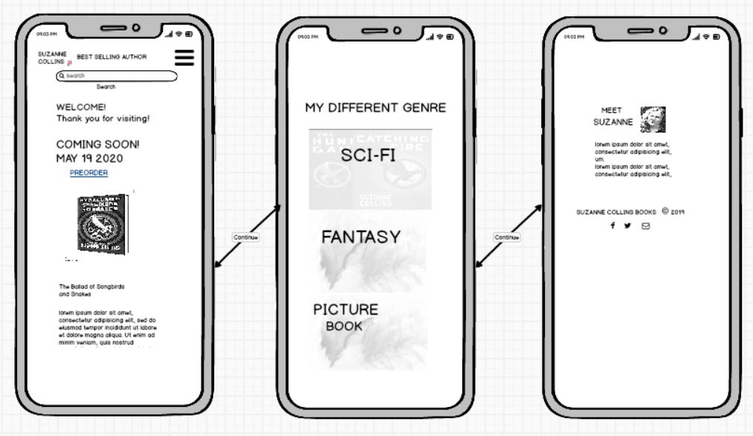
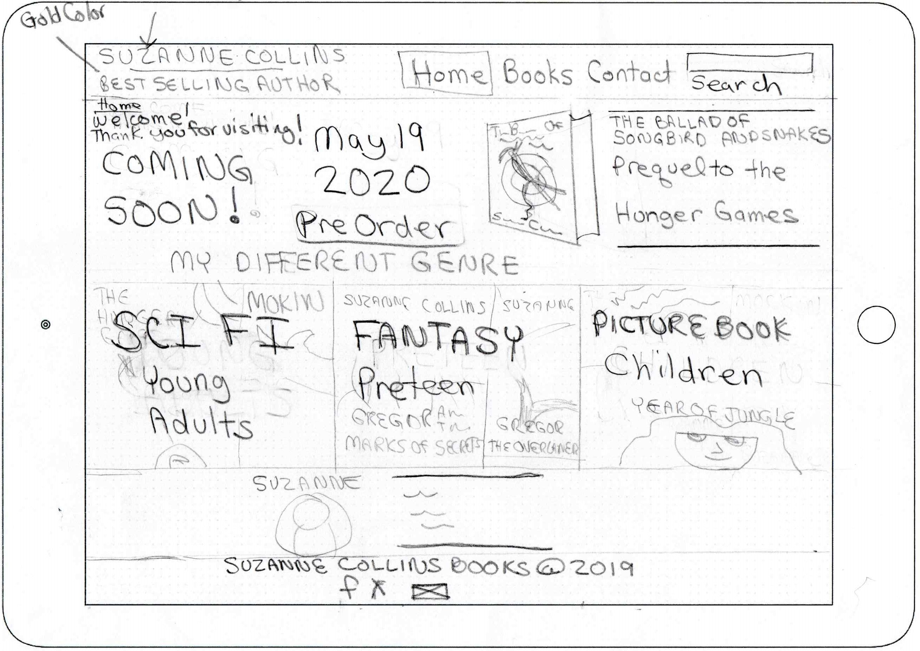
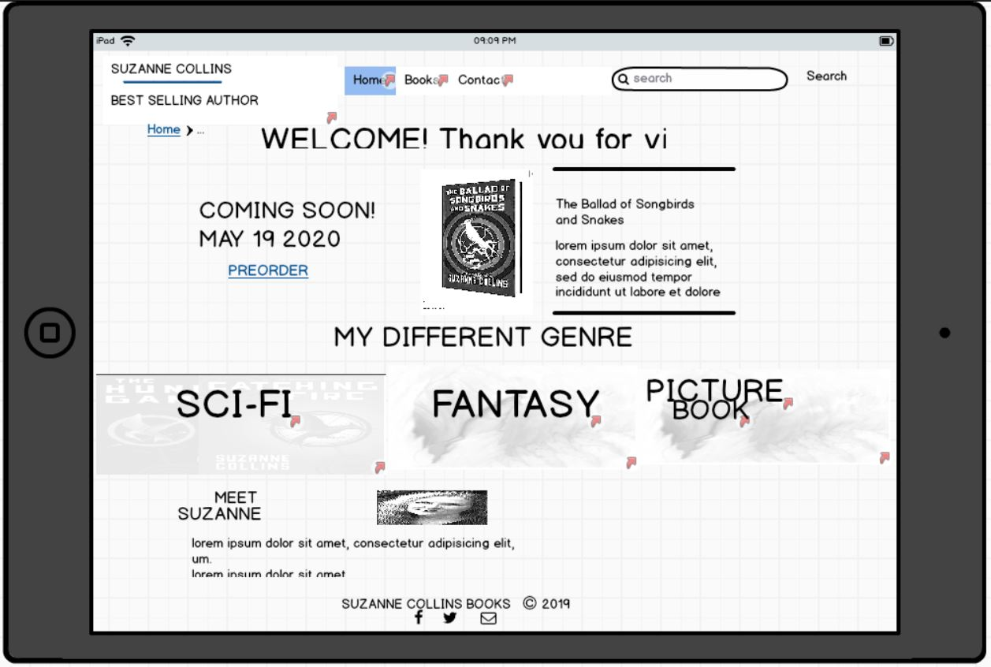
WIREFRAMES
HOME Page
Goal: user recognizes site is for SC books
Header includes author name
Recent release Book information
Sketch to Digital
All media sizes
DESKTOP
Sketch
Digital
MOBILE
Digital
TABLET
Sketch
Digital
Mobile First Design
Tablet
Relocated Suzanne Section to bottom
to reduce clutter
WWW.SUZANNECOLLINSBOOKS.COM

Slide 26
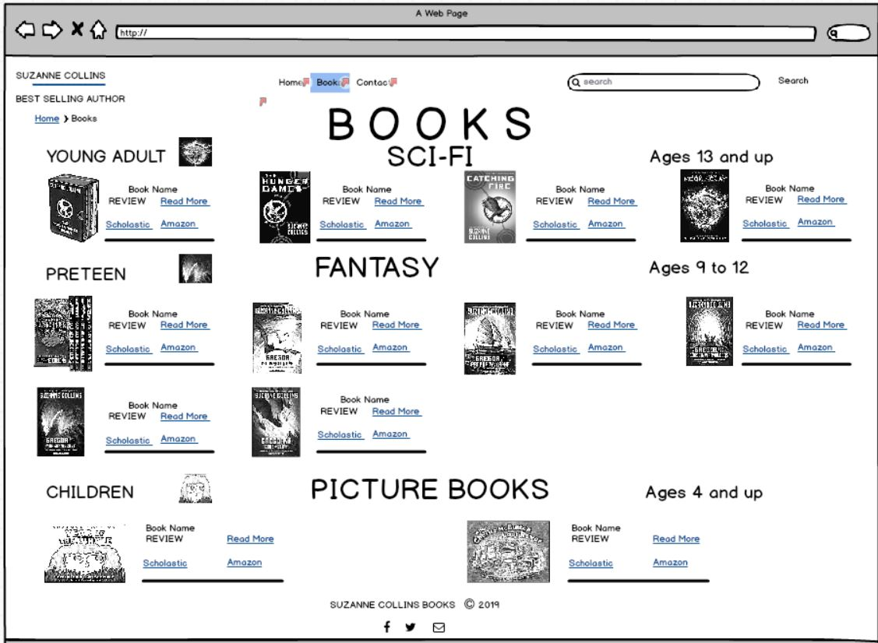
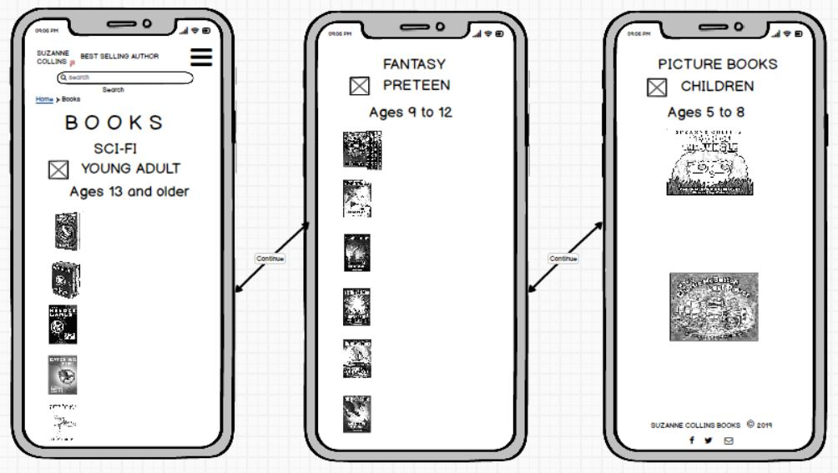
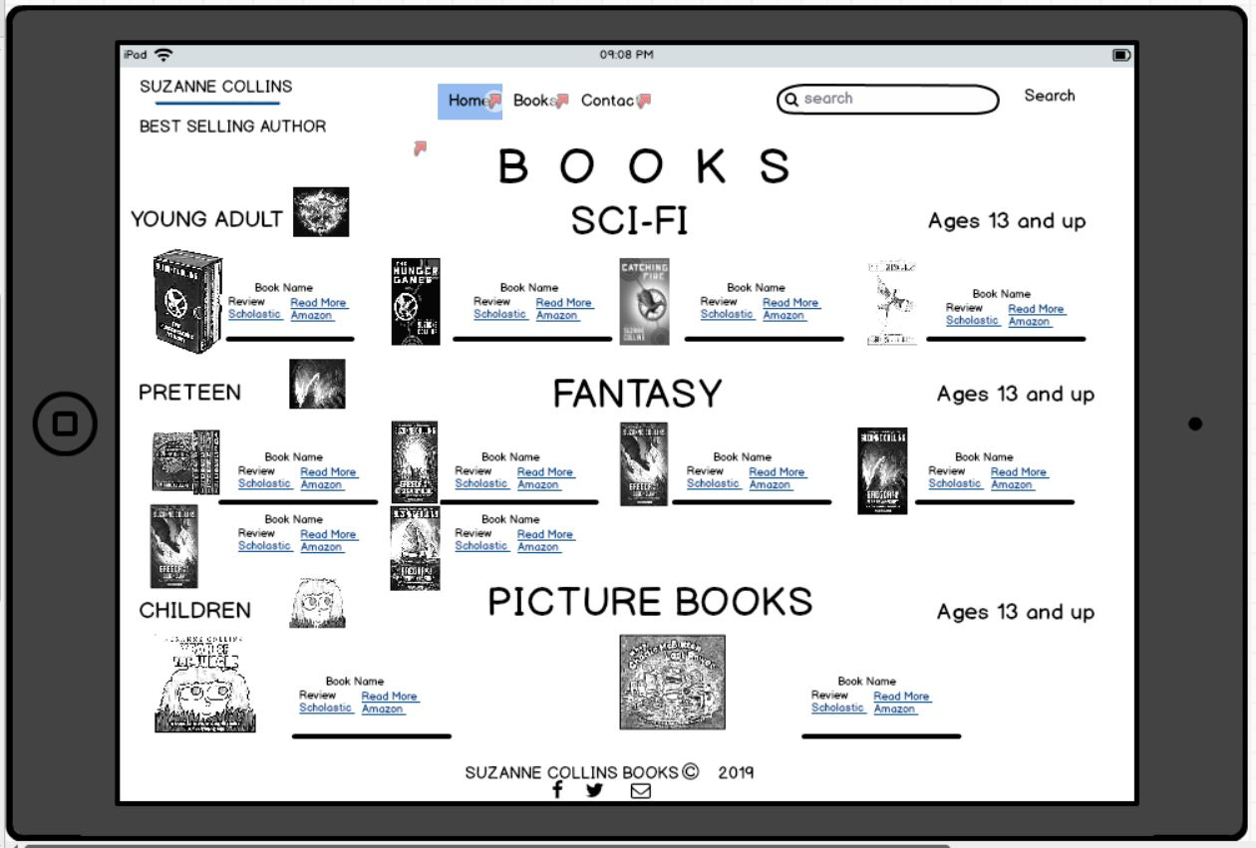
WIREFRAMES
BOOKS Page
Sketch to Digital
All media sizes
Organized by Genre and age recommendation
DESKTOP
Sketch
Digital
MOBILE
Digital
TABLET
Digital
Sketch
Mobile First Design
WWW.SUZANNECOLLINSBOOKS.COM

Slide 27
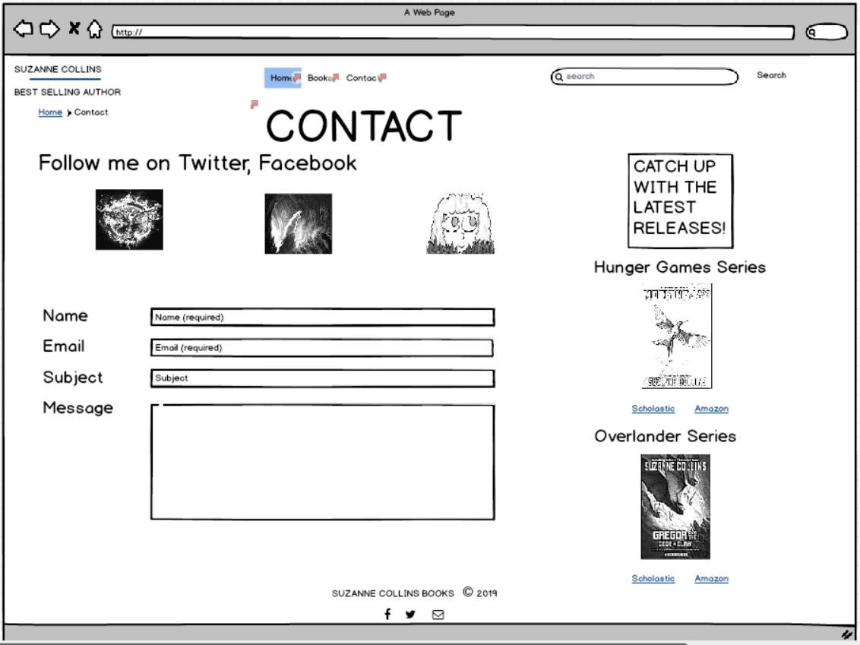
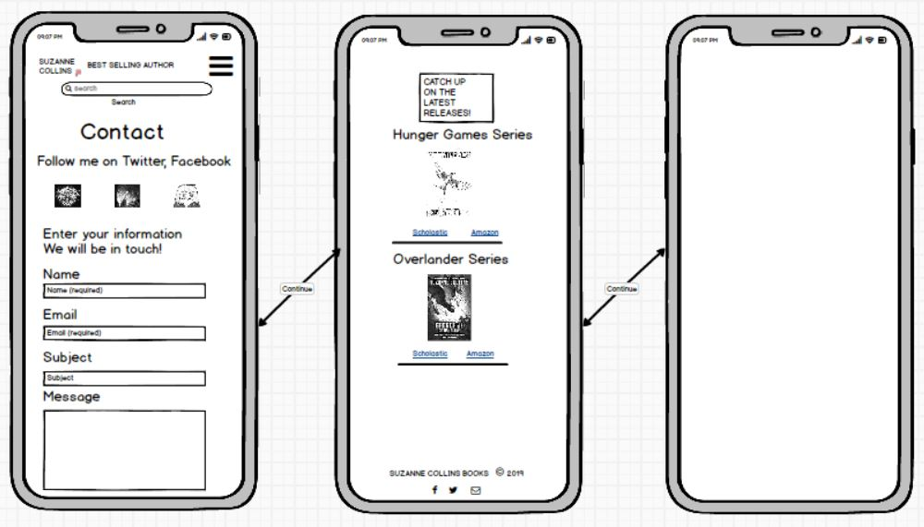
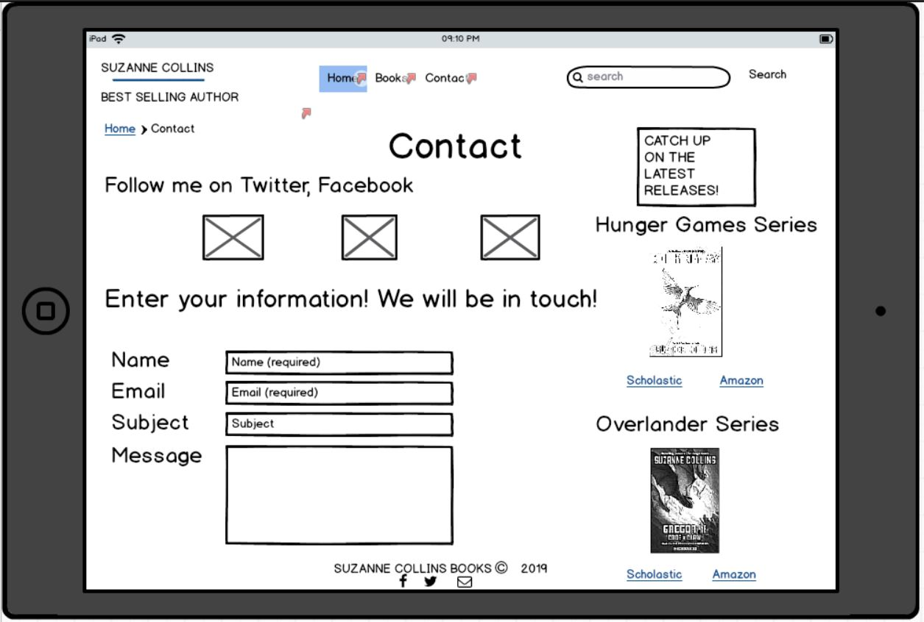
WIREFRAMES
CONTACT Page
Sketch to Digital
All media sizes
Sketch
DESKTOP
Digital
MOBILE
Digital
TABLET
Digital
Sketch
Mobile First Design
WWW.SUZANNECOLLINSBOOKS.COM

Slide 28
Redesign Site
ANALYZE/
PLANNING
WIREFRAME SKETCHES
USER TEST Original Site
PERSONA /
JOURNEY MAP
DIGITAL
WIREFRAME
PROTOTYPE
USER TEST Prototype
WWW.SUZANNECOLLINSBOOKS.COM

Slide 29
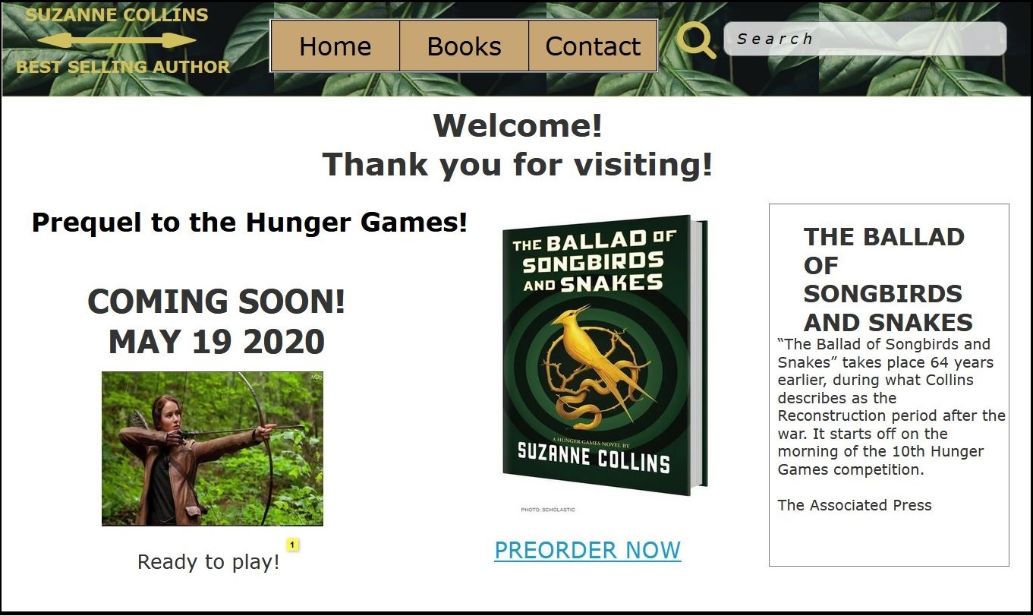


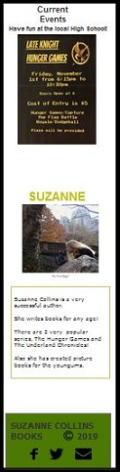
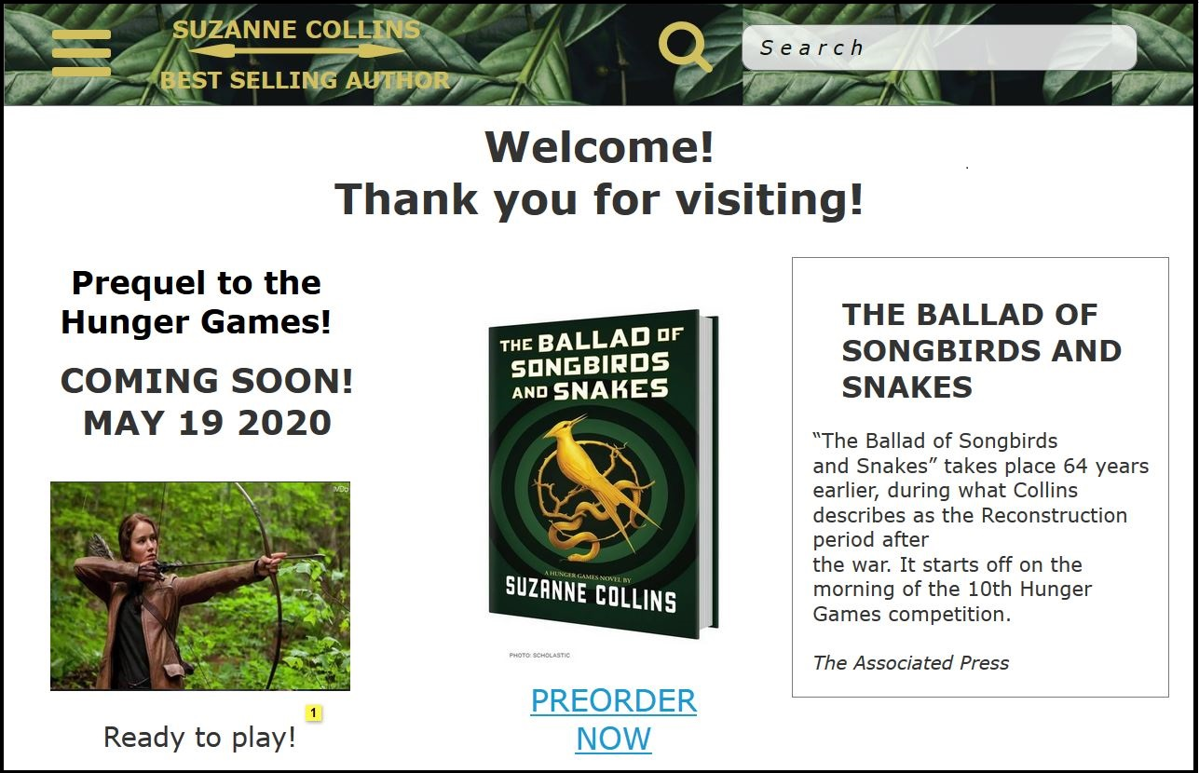
HOME Page
Digital to Prototype
All media sizes
DESKTOP
Digital
Prototype
MOBILE
Digital
Prototype
TABLET
Digital
Prototype
WWW.SUZANNECOLLINSBOOKS.COM

Slide 30
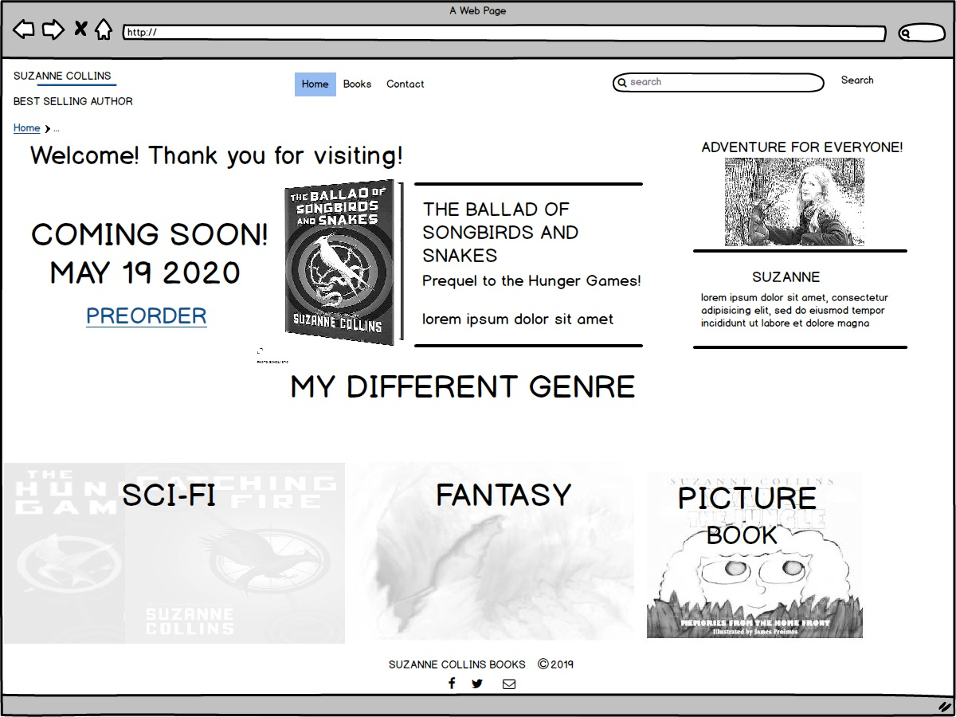
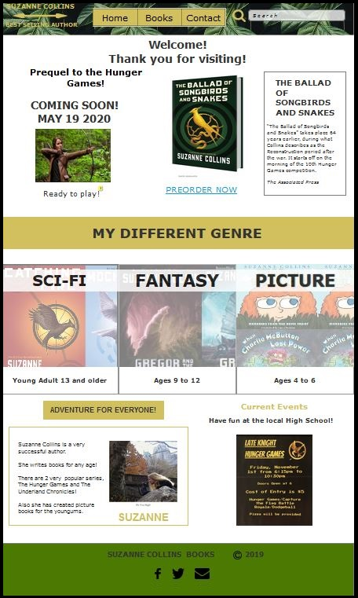
HOME Page
Digital to Prototype
DESKTOP
Digital
Prototype
MOBILE
Digital
Prototype
Prototype
Added
Hunger Games image
Current Events
WWW.SUZANNECOLLINSBOOKS.COM

Slide 31
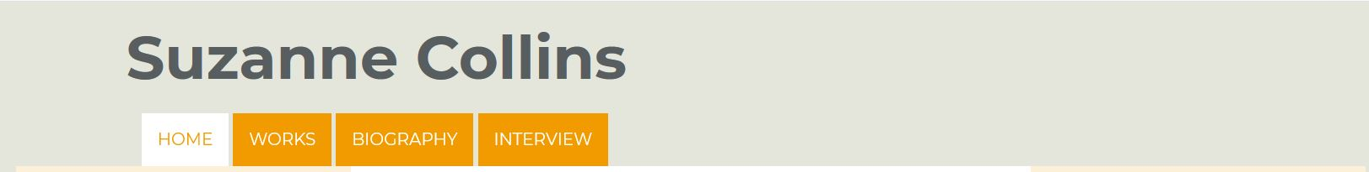

NAVIGATION Redesign
Original to Prototype
Original
Tab Style Navigation
No Search
Not engaging user
Prototype
Modern Navigation
Drop down
Search
Colorful
BEST SELLING AUTHOR
Large Readable Font
WWW.SUZANNECOLLINSBOOKS.COM

Slide 32
Home Page Improvements
Original to Prototype
Original
Modern Navigation with Search
BEST SELLING AUTHOR
Prototype
Tab Style Navigation
No search
Book images
Book reviews
Too much white space
Small hard to read Font
Coming Soon
With image
Large Font
Organized
Genre / Age
Mouseover effect
to select book type
Author introduction and current events
WWW.SUZANNECOLLINSBOOKS.COM

Slide 33
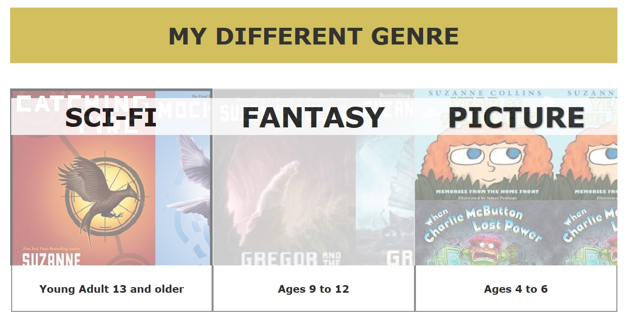
Home Page Improvement
Prototype
Mouseover effect for selection
Easy to use
Fun
Organized
WWW.SUZANNECOLLINSBOOKS.COM

Slide 34

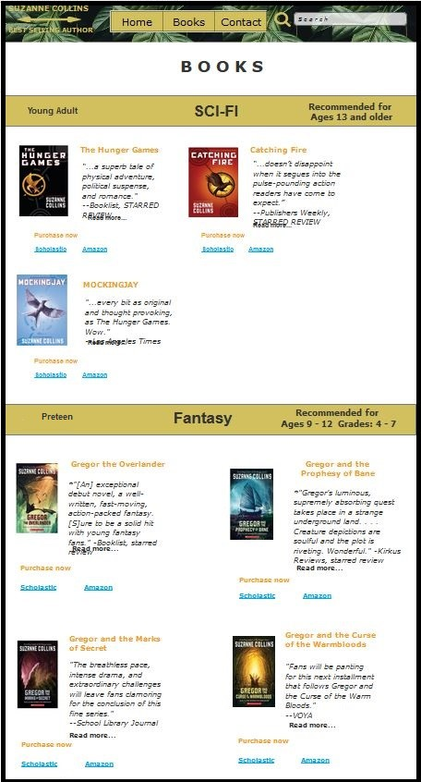
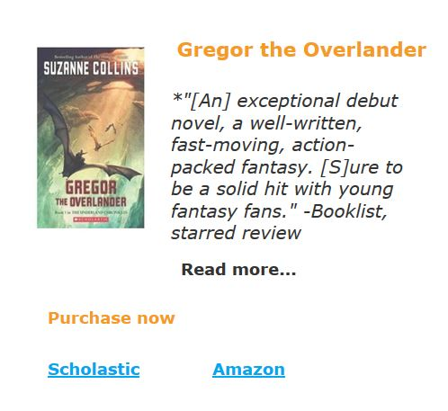
Books Page
Original to Prototype
WWW.SUZANNECOLLINSBOOKS.COM
Original
Prototype
Listing of books
Links go to awards/reviews
Organized
Genre / Age
Links
Page detail
Read more…
Purchase

Slide 35
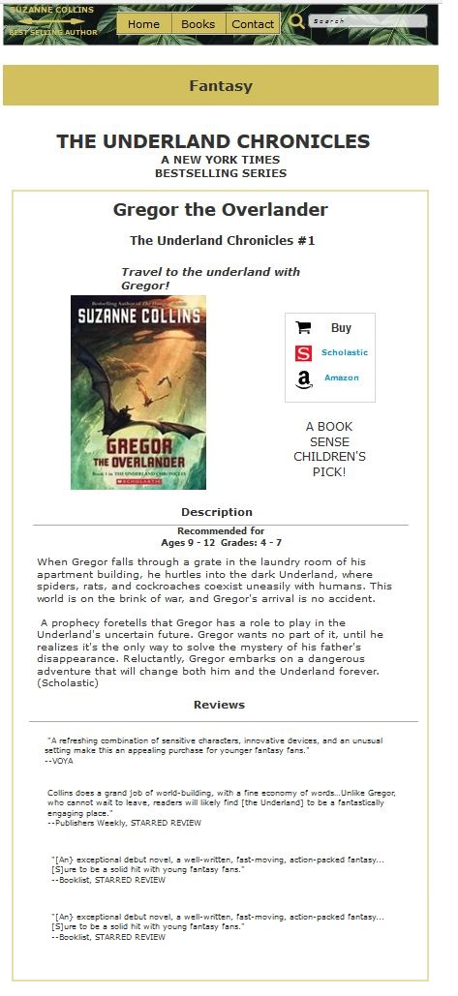
Books Page with detail
Prototype
WWW.SUZANNECOLLINSBOOKS.COM
Prototype
Organized
Genre / Age
Book Detail
Links TO
Page detail Purchase
Read more…

Slide 36
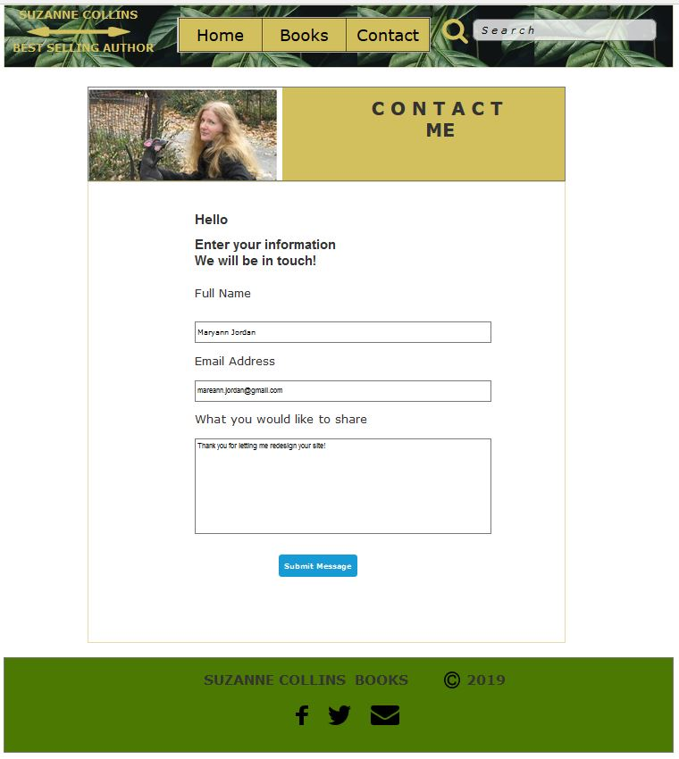
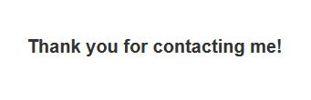
Contact Page
Prototype
WWW.SUZANNECOLLINSBOOKS.COM
Prototype
Contact Response
User
Name
Email
Message

Slide 37
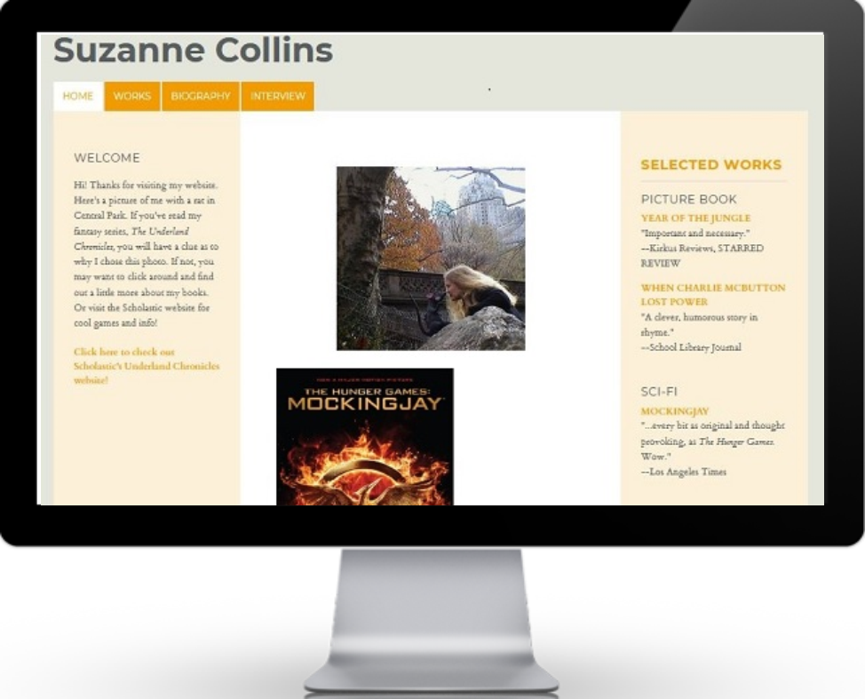

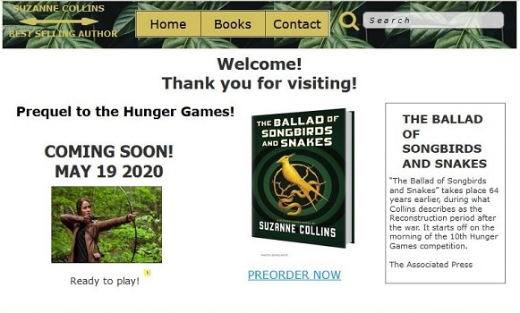
HOME Page
Original to Prototype
DESKTOP
ORIGINAL
REDESIGNED
OLD STYLE NAVIGATION
FLAT STYLE NAVIGATION
HARD TO READ FONT
LARGE FONT
OLD STYLE
MODERN DESIGN
MELLOW COLORS
COLORFUL
WWW.SUZANNECOLLINSBOOKS.COM

Slide 38
Redesign Site
ANALYZE
WIREFRAME SKETCHES
USER TEST Original Site
PERSONA /
JOURNEY MAP
DIGITAL
WIREFRAME
PROTOTYPE
USER TEST Prototype
WWW.SUZANNECOLLINSBOOKS.COM

Slide 39
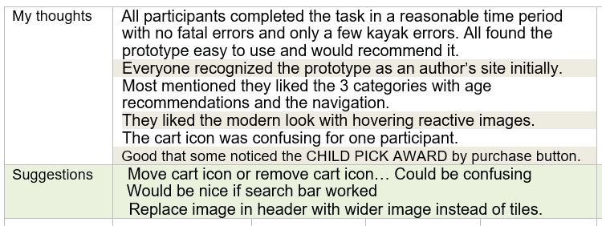
Prototype
User Test 2
Scenario:
Purchase a specific book for children ages 9 and 10 (select vendor link).
Results: Users were all able to purchase book
Issues: Cart icon is not clickable
Improve: purchase area
WWW.SUZANNECOLLINSBOOKS.COM

Slide 40
Prototype
User Test 2 Debriefing
Comments
Clean
Modern
Easy to navigate with 3 menu items
Nice. Young children can use
Professional
Attract readers with up to date section
Good for everyone
Like social media on footer
Like interactive images
Intuitive
Organized
Scenario: Purchase a specific book
Debriefing shows positive user experience
Users would recommend site
WWW.SUZANNECOLLINSBOOKS.COM

Slide 41
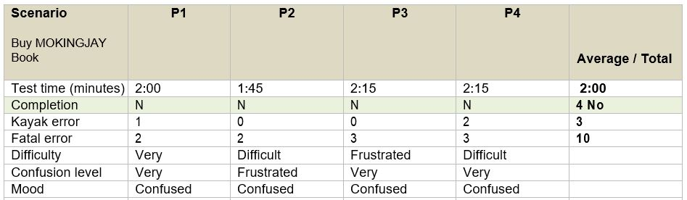

USER TESTS Comparison
Original to Prototype
Original Site
Comments
Unprofessional
Bad Design
Lacking Functionality
Difficulty: Very
Mood: Confused
Recommend: 75% NO
TASK: Purchase a specific book
Improvements
Average Time 60% less
Fatal Errors 100% less
Prototype
Comments
Professional
Good for everyone
Intuitive
Organized
Difficulty: Easy
Mood: Good
Recommend: 100% YES
WWW.SUZANNECOLLINSBOOKS.COM

Slide 42
Why redesign SUZANNECOLLINSBOOKS.COM?
A popular author should have a modern designed website which is user friendly. ☺
The improvements I would make to the prototype are
- add latest releases, fun character
images to contact page
- improve contact response page
- add bio page
- improve purchase area
- put wider image in navigation section
(instead of tiles)

Slide 43

WWW.SUZANNECOLLINSBOOKS.COM
Thank you!
Have a good day!
Special thanks to our teacher Jennie Johns!

Slide 44
WHO WE ARE
Proactively envisioned multimedia based expertise and cross-media growth strategies. Seamlessly visualize quality intellectual capital without superior collaboration and idea-sharing. Interactively coordinate proactive e-commerce via process-centric "outside the box" thinking. Completely pursue scalable customer service.

Slide 45
Proactively envisioned multimedia based expertise and cross-media growth strategies. Seamlessly visualize quality intellectual capital without superior collaboration and idea-sharing. Interactively coordinate proactive e-commerce via process-centric "outside the box" thinking.
OUR LIST
VISION
Observation
Consultation
Leverage agile frameworks to provide a robust synopsis for high level views new normal that has.
Leverage agile frameworks to provide a robust synopsis for high level views new normal that has.

Slide 46
OUR LIST
VISION
Good Service
Predominate extensible testing procedures for reliable good views new normal that ensure.
Interactively coordinate proactive e-commerce via process-centric "outside the box" thinking. Completely pursue scalable customer service through sustainable potentialities collaboratively administrate.
Notification
Predominate extensible testing procedures for reliable good views new normal that ensure.

Slide 47
OUR SERVICE
Proactively envisioned multimedia based expertise and cross-media growth strategies. Seamlessly visualize quality intellectual capital without superior collaboration and idea.
Observation
01
Leverage agile frameworks to provide a robust synopsis for high level views new normal that.
Consultation
02
Leverage agile frameworks to provide a robust synopsis for high level views new normal that.
Resolution
03
Leverage agile frameworks to provide a robust synopsis for high level views new normal that.

Slide 48
OUR LIST
SERVICE
Proactively envisioned multimedia based expertise and cross-media growth strategies. Seamlessly visualize quality intellectual capital without superior collaboration and idea-sharing interactively.
Observation
Proactively envisioned multimedia based expertise and cross-media growth strategies. Seamlessly visualize quality intellectual capital.
Consultation
Proactively envisioned multimedia based expertise and cross-media growth strategies. Seamlessly visualize quality intellectual capital.

Slide 49
START THE TIMELINE
Bring to the table win-win survival strategies to ensure proactive domination. At the end of the day, going forward, a new normal that has evolved from generation X is on the runway heading towa solution. User generated content in real-time will.

Slide 50
Make Strategy and Plan
Proactively envisioned multimedia based expertise and cross-media growth strategies. Seamlessly visualize quality intellectual capital without superior.
Succes The Project
Meet With Team
Proactively envisioned multimedia based expertise and cross-media growth strategies. Seamlessly visualize quality intellectual capital without superior.
Proactively envisioned multimedia based expertise and cross-media growth strategies. Seamlessly visualize quality intellectual capital without superior.

Slide 51
GOAL THE TIMELINE
Bring to the table win-win survival strategies to ensure proactive domination. At the end of the day, going forward, a new normal that has evolved from generation X is on the runway heading towa solution. User generated content in real-time will collaboratively administrate empowered markets podcasting.

Slide 52
BUSINESS PACK
BUSINESS PACK
PRICING
TABLE PRODUCT
$120/mo
$220/mo
Special Service
Ultimate Service
500 GB Disk Space
1 TB Disk Space
Jonnedlsfaln
Ss;klfnsdkfls
Fsdfl;kdn
Sdfno;sdfn
Good Quality Product
High Quality Product
Door Prize
Door Prize
Purchase
Purchase

Slide 53
SINGLE
PORTOFOLIO
WWW.LAVIEN.COM
Proactively envisioned multimedia based expertise and cross-media growth strategies. Seamlessly visualize quality intellectual capital without superior collaboration and idea-sharing. Interactively coordinate proactive e-commerce via process-centric.

Slide 54
Interactively coordinate proactive
e-commerce via process-centric "outside the box" thinking. Completely pursue scalable customer service through sustainable potentialities collaboratively administrate.
SINGLE
PORTOFOLIO
Marketing Project
Collaboratively administrate empowered markets via plug-and-play networks. Dynamic procrastinate B2C users after installed base benefits dramatic visualize. Predominate extensible testing procedures for reliable good views.
WWW.LAVIEN.COM

Slide 55
SINGLE
PORTOFOLIO
Collaboratively administrate empowered markets via plug-and-play networks. Dynamic procrastinate B2C users after installed base benefits dramatic visualize. Predominate extensible testing procedures for reliable good views Proactively envisioned multimedia based expertise and cross-media growth.

Slide 56
Collaboratively administrate empowered markets via plug-and-play networks. Dynamic procrastinate B2C users after installed base benefits dramatic visualize.
Predominate extensible testing procedures for reliable good views Proactively envisioned multimedia based expertise and cross-media growth strategies. Seamlessly visualize quality intellectual capital without superior.
SINGLE
PORTOFOLIO

Slide 57
Collaboratively administrate empowered markets via plug-and-play networks. Dynamic procrastinate B2C users after installed base benefits dramatic visualize.
Predominate extensible testing procedures for reliable good views Proactively envisioned multimedia based expertise and cross-media growth strategies. Seamlessly visualize quality intellectual capital without superior.
SINGLE
PORTOFOLIO

Slide 58
HOME PAGE DESKTOP
ORIGINAL
REDESIGNED
OLD STYLE NAVIGATION
FLAT STYLE NAVIGATION
FLAT STYLE NAVIGATION
HARD TO READ FONT
LARGE FONT
COLORFUL
OLD STYLE
MODERN DESIGN
FLAT STYLE NAVIGATION
MELLOW COLORS
COLORFUL
COLORFUL

Slide 59
HOME PAGE DESKTOP
ORIGINAL
REDESIGNED
OLD STYLE NAVIGATION
FLAT STYLE NAVIGATION
FLAT STYLE NAVIGATION
HARD TO READ FONT
LARGE FONT
COLORFUL
OLD STYLE
MODERN DESIGN
FLAT STYLE NAVIGATION
MELLOW COLORS
COLORFUL
COLORFUL

Slide 60
SINGLE SLIDE
UNIQUE PORTOFOLIO
Interactively coordinate proactive
e-commerce via process-centric "outside the box" thinking. Completely pursue scalable customer service through sustainable potentialities collaboratively.
Collaboratively administrate empowered markets via plug-and-play networks. Dynamic procrastinate B2C users after installed base benefits dramatic visualize Bring to the table win-win survival strategies to ensure proactive domination.

Slide 61

WWW.SUZANNECOLLINSBOOKS.COM
DESKTOP
ORIGINAL
PROTOTYPE

Slide 62
Interactively coordinate proactive e-commerce via process-centric "outside the box" thinking. Completely pursue scalable customer service through sustainable potentialities. Collaboratively administrate turnkey channels whereas virtual e-tailers.
Proactively envisioned multimedia based expertise and cross-media growth strategies. Seamlessly visualize quality intellectual capital without superior collaboration and idea-sharing. Interactively coordinate proactive e-commerce via process-centric.
DOUBLE
IMAGE SLIDE

Slide 63
MAIN PAGE
REDESIGN
READABILITY
CURRENT
ORGANIZED
HARD TO READ
OLD STYLE
WHITESPACE
Original
Improved
WWW.SUZANNECOLLINSBOOKS.COM

Slide 64
Service Center
Predominate extensible testing procedures for reliable good views new normal that ensure customer service through finished.
DOUBLE
IMAGE SLIDE
Strategy Marketing
Predominate extensible testing procedures for reliable good views new normal that ensure customer service through finished.

Slide 65
ABOUT US
Proactively envisioned multimedia based expertise and cross-media growth strategies. Seamlessly visualize quality intellectual capital without superior collaboration and idea-sharing.
Interactively coordinate proactive e-commerce via process-centric "outside the box" thinking. Completely pursue scalable customer service through sustainable potentialities. Collaboratively administrate turnkey channels whereas virtual e-tailers.

Slide 66
WWW.LAVIEN.COM
DOUBLE
IMAGE SLIDE
Interactively coordinate proactive
e-commerce via process-centric "outside the box" thinking. Completely pursue scalable customer service through sustainable potentialities collaboratively.

Slide 67
BREAK
SLIDE
There is only one boss. The customer. And he can fire everybody in the company from the chairman on down, simply by spending his money somewhere else.
- Sam Walton

Slide 68
Collaboratively administrate empowered markets via plug-and-play networks. Dynamic procrastinate B2C users after installed base benefits.
WWW.LAVIEN.COM
Interactively coordinate proactive
e-commerce via process-centric "outside the box" thinking. Completely pursue scalable customer service through sustainable potentialities collaboratively.
DOUBLE
IMAGE SLIDE

Slide 69
WWW.LAVIEN.COM
DOUBLE
IMAGE SLIDE
Marketing Project
Collaboratively administrate empowered markets via plug-and-play networks. Dynamic procrastinate B2C users after installed base benefits dramatic visualize. Predominate extensible testing procedures for reliable good views.

Slide 70
Collaboratively administrate empowered markets via plug-and-play networks. Dynamic procrastinate B2C users after installed base benefits dramatic visualize Bring to the table win-win survival strategies to ensure proactive domination.
DOUBLE
IMAGE SLIDE
Collaboratively administrate empowered markets via plug-and-play networks. Dynamic procrastinate B2C users after installed base benefits dramatic visualize Bring to the table win-win survival strategies to ensure proactive domination.

Slide 71
Proactively envisioned multimedia based expertise and cross-media growth strategies. Seamlessly visualize quality intellectual capital without superior collaboration and idea-sharing interactively.
TRIPLE
IMAGE SLIDE
WWW.LAVIEN.COM

Slide 72
Interactively coordinate proactive
e-commerce via process-centric "outside the box" thinking. Completely pursue scalable customer service through sustainable potentialities collaboratively administrate.
TRIPLE
IMAGE SLIDE
WWW.LAVIEN.COM

Slide 73
MEET
WITH LEADER
THOMASSON DALBERT
CEO Lavien Company
WWW.LAVIEN.COM
Proactively envisioned multimedia based expertise and cross-media growth strategies. Seamlessly visualize quality intellectual capital without superior collaboration.
Team Work
95%
Leaders Team
100%
Design
80%

Slide 74
MEET
WITH TEAM
Collaboratively administrate empowered markets via plug-and-play networks. Dynamic procrastinate B2C users after installed base benefits dramatic visualize. Predominate extensible testing.
NATHALIE GREEN
ROBERT YOHANES
TANIALIA HILL
Design Graphic
Web Design
Web Development
Predominate extensible testing procedures for reliable good views new normal scalable.
Predominate extensible testing procedures for reliable good views new normal scalable.
Predominate extensible testing procedures for reliable good views new normal scalable.

Slide 75
MEET WEB
DESIGN TEAM
Collaboratively administrate empowered markets via plug-and-play networks. Dynamic procrastinate B2C users after installed base benefits dramatic visualize. Predominate extensible testing procedures for reliable good views Proactively envisioned multimedia based expertise and cross-media growth.
Interactively coordinate proactive e-commerce via process-centric "outside the box" thinking. Completely pursue scalable customer service through sustainable potentialities collaboratively.

Slide 76
COMPANY
QUOTES
There is only one boss. The customer. And he can fire everybody in the company from the chairman on down, simply by spending his money somewhere else.
- Sam Walton

Slide 77







Home Page
DESKTOP
WIREFRAMES with Prototype
Digital
TABLET
MOBILE
Sketch
Sketch
Sketch
Digital
Digital
Prototype
Prototype
Prototype
WWW.SUZANNECOLLINSBOOKS.COM

Slide 78
COMPANY
QUOTES
Individual commitment to a group effort that is what makes a team work, a company work, a society
WWW.LAVIEN.COM
- Vince Lombard

Slide 79
WWW.SUZANNECOLLINSBOOKS.COM
WIREFRAMES
Home Page
DESKTOP
TABLET
MOBILE

Slide 80
WWW.SUZANNECOLLINSBOOKS.COM
WIREFRAMES
DESKTOP
HOME PAGE
MOBILE
TABLET

Slide 81
ORIGINAL SITE
ISSUES
UNORGANIZED WHITE SPACE
SMALL FONT
OLD STYLE NAVIGATION
HARD TO PURCHASE BOOKS
NO CONTACT INFORMATION
LACK OF ORGANIZATION / HEADERS
IMAGES UNCLICKABLE

Slide 82
CLIENT TESTIMONIAL
NATALIA ISABELLA MIRANDA
CEO Diamond Company
Collaboratively administrate empowered markets via plug-and-play networks. Dynamic procrastinate B2C users after installed base benefits dramatic visualize Bring to the table win-win survival strategies to ensure proactive domination.
WWW.LAVIEN.COM

Slide 83
BREAK
SLIDE
WWW.LAVIEN.COM

Slide 84
HOME PAGE
WORKS PAGE
ORIGINAL SITE
ISSUES
UNORGANIZED WHITE SPACE
SMALL FONT
OLD STYLE NAVIGATION
HARD TO PURCHASE BOOKS
NO CONTACT INFORMATION
LACK OF ORGANIZATION
NO FOOTER
IMAGES UNCLICKABLE
WWW.SUZANNECOLLINSBOOKS.COM

Slide 85

text

Slide 86

MOCKUP
DEVICE LAYOUT
Collaboratively administrate empowered markets via plug-and-play networks. Dynamic procrastinate B2C users after installed base benefits dramatic visualize. Predominate extensible testing procedures for reliable good views Proactively envisioned multimedia based expertise and cross-media growth.

Slide 87

MOCKUP
DEKSTOP LAYOUT
Collaboratively administrate empowered markets via plug-and-play networks. Dynamic procrastinate B2C users after installed base benefits dramatic visualize.
WWW.LAVIEN.COM

Slide 88
Collaboratively administrate empowered markets via plug-and-play networks. Dynamic procrastinate B2C users after installed base benefits dramatic visualize.
WWW.LAVIEN.COM
MOCKUP
DEKSTOP LAYOUT

Slide 89

Collaboratively administrate empowered markets via plug-and-play networks. Dynamic procrastinate B2C users after installed base benefits dramatic visualize.
WWW.LAVIEN.COM
MOCKUP
DEKSTOP LAYOUT

Slide 90
Collaboratively administrate empowered markets via plug-and-play networks. Dynamic procrastinate B2C users after installed base benefits dramatic visualize.
WWW.LAVIEN.COM
MOCKUP
DEKSTOP LAYOUT

Slide 91


Collaboratively administrate empowered markets via plug-and-play networks. Dynamic procrastinate B2C users after installed base benefits dramatic visualize.
WWW.LAVIEN.COM
MOCKUP
DEKSTOP LAYOUT

Slide 92

Collaboratively administrate empowered markets via plug-and-play networks. Dynamic procrastinate B2C users after installed base benefits dramatic visualize.
WWW.LAVIEN.COM
MOCKUP
DEKSTOP LAYOUT

Slide 93
Collaboratively administrate empowered markets via plug-and-play networks. Dynamic procrastinate B2C users after installed base benefits dramatic visualize.
WWW.LAVIEN.COM
MOCKUP
DEKSTOP LAYOUT

Slide 94

SMART WATCH
MOCKUP LAYOUT
74%
Collaboratively administrate empowered markets via plug-and-play networks. Dynamic procrastinate B2C users after installed base benefits dramatic visualize. Predominate extensible testing procedures for reliable good.
Your Title Here
Leverage agile frameworks to provide a robust synopsis for high level views.

Slide 95

HOME PAGE TABLET
ORIGINAL
REDESIGNED
WWW.LAVIEN.COM
MOCKUP
TABLET LAYOUT
Collaboratively administrate empowered markets via plug-and-play networks. Dynamic procrastinate B2C users after installed base benefits dramatic visualize. Predominate extensible testing procedures for reliable good.

Slide 96
MOCKUP
TABLET LAYOUT
WWW.LAVIEN.COM
Collaboratively administrate empowered markets via plug-and-play networks. Dynamic procrastinate B2C users after installed base benefits dramatic visualize. Predominate extensible testing procedures for reliable good.
Team Work
95%
Leaders Team
100%

Slide 97
SIMPLE
INFOGRAPHIC
Collaboratively administrate empowered markets via plug-and-play networks. Dynamic procrastinate B2C users after installed base benefits dramatic visualize. Predominate extensible testing procedures for reliable good views Proactively envisioned multimedia based expertise and cross-media growth.
WWW.LAVIEN.COM

Slide 98
74%
Your Title Here
SIMPLE
INFOGRAPHIC
Leverage agile frameworks to provide a robust synopsis for high level views.
Collaboratively administrate empowered markets via plug-and-play networks. Dynamic procrastinate B2C users after installed base benefits dramatic visualize. Predominate extensible testing procedures for reliable good views Proactively envisioned multimedia based expertise and cross-media growth.
62%
Your Title Here
Leverage agile frameworks to provide a robust synopsis for high level views.

Slide 99
85%
Sales
75%
Sales
SIMPLE
INFOGRAPHIC
65%
Sales
2017
2018
55%
Sales
45%
Sales
2016
WWW.LAVIEN.COM
35%
Sales
2019
2020
2015
Collaboratively administrate empowered markets via plug-and-play networks. Dynamic procrastinate B2C users after installed base benefits dramatic visualize. Predominate extensible testing procedures for reliable good views.

Slide 100
WORLD MAP
GRAPHIC
Leverage agile frameworks to provide a robust synopsis for high level views new normal that has.
Leverage agile frameworks to provide a robust synopsis for high level views new normal that has.

Slide 101
EUROPEAN MAP
GRAPHIC
Collaboratively administrate empowered markets via plug-and-play networks. Dynamic procrastinate B2C users after installed base benefits dramatic visualize. Predominate extensible testing procedures for reliable good.
Team Work
95%
Leaders Team
WWW.LAVIEN.COM
100%

Slide 102
IMPROVEMENT TO
USER EXPERIENCE
WWW.LAVIEN.COM
Collaboratively administrate empowered markets via plug-and-play networks. dynamic procrastinate B2C users after installed base benefits. Dramatically visualize customer.
74%
62%

Slide 103
UNITED KINGDOMS
GRAPHIC
WWW.LAVIEN.COM
Collaboratively administrate empowered markets via plug-and-play networks. dynamic procrastinate B2C users after installed base benefits. Dramatically visualize customer.
74%
62%

Slide 104
IMAGE
SLIDE DESIGN

Slide 105
IMAGE
SLIDE DESIGN

Slide 107
WWW.SUZANNECOLLINSBOOKS.COM
WIREFRAMES
TABLET
MOBILE
HOME PAGE
DESKTOP

Slide 108
HOME PAGE WIREFRAMES

Slide 109
HOME PAGE WIREFRAMES

Slide 110
HOME PAGE WIREFRAMES

Slide 111
WIREFRAMES

Slide 112
THANKS
FOR
WATCHING
WWW.LAVIEN.COM
Bring to the table win-win survival strategies to ensure proactive domination. At the end of the day, going forward, a new normal that has evolved from generation X is on the runway heading towa solution. User generated content in real-time will collaboratively.

Slide 113
ORIGINAL FRONT PAGE

Slide 114
WELCOME MESSAGE
Proactively envisioned multimedia based expertise and cross-media growth strategies. Seamlessly visualize quality intellectual capital without superior collaboration and idea-sharing. Interactively coordinate proactive e-commerce via process-centric "outside the box" thinking. Completely pursue scalable customer service.
Learn More…

Slide 115
WELCOME MESSAGE
Proactively envisioned multimedia based expertise and cross-media growth strategies. Seamlessly visualize quality intellectual capital without superior collaboration and idea-sharing. Interactively coordinate proactive e-commerce via process-centric "outside the box" thinking. Completely pursue scalable customer service.
Learn More…

Slide 127


USER TEST RESULTS
ORIGINAL SITE
Difficulty: Very
Mood: Confused
Recommend: 75% NO
Errors
3 KAYAK
10 FATAL
Average Time
2 minutes
Comments: Unprofessional
Bad Design
Lacking Functionality
Average Time:
60% improvement
PROTOTYPE
Difficulty: Easy
Mood: Good
Recommend: 100% YES
Errors
3 KAYAK
0 FATAL
Average Time
1.2 minutes
Comments: Professional
Good for everyone
Intuitive
Organized

